Slide 1
Constructing RDA Access Points
Adam L. Schiff
Principal Cataloger
University of Washington Libraries
aschiff@uw.edu

Slide 2
Goals
To understand the key changes in constructing access points in RDA compared to AACR2, with emphasis on authorized access points
To get some practice constructing authorized access points for some types of resources commonly encountered by OLAC attendees
To gain familiarity with changes in terminology from AACR2 to RDA
To gain familiarity with RDA instructions for recording relationships
To review some of the new MARC 21 fields for recording attributes of persons, families, corporate bodies, and works and expressions

Slide 3
AACR2 vs. RDA Terminology
AACR2
RDA
heading
author, composer, artist, etc.
main entry
uniform title
see reference
see also reference
authorized access point
creator
preferred title or authorized access point for creator + preferred title
1. preferred title and any differentiating info
2. a conventional collective title, e.g. Works; Symphonies; Poems
variant access point
authorized access point for related entity
Notes:
Information in this slide is taken from RDA: Module 1--Introduction to RDA; Identifying Manifestations and Items, developed by Tim Carlton and Jessalyn Zoom. Cooperative and Instructional Programs Division, Library of Congress, September 2012. Online at http://www.loc.gov/catworkshop/RDA%20training%20materials/LC%20RDA%20Training/Module1IntroManifestItemsSept12.doc

Slide 4
Access Points for Works and Expressions
RDA Chapters 5-6

Slide 5
5.3 Work Core Elements
When recording data identifying a work, include as a minimum the elements listed below that are applicable and readily ascertainable.
Preferred title for the work
Identifier for the work
When the preferred title is recorded as part of the authorized access point representing the work, precede it, if appropriate, by the authorized access point representing the person, family, or corporate body responsible for the work, as specified in the instructions given under 6.27.1.

Slide 6
Work Core Elements
If the preferred title for a work is the same as or similar to a title for a different work, or to a name for a person, family, or corporate body, record as many of the additional identifying elements listed below as necessary to differentiate them. Record the elements either as additions to the access point representing the work, as separate elements, or as both.
Form of work MARC Bibliographic/Authority 380
Date of work MARC Bibliographic/Authority 046 $k $l
Place of origin of the work MARC Authority 370 $g
Other distinguishing characteristic of the work MARC Bibliographic/Authority 381

Slide 7
Work Core Elements
When identifying a musical work with a title that is not distinctive, record as many of the following elements as are applicable. For musical works with distinctive titles, record as many of the following elements as necessary to differentiate the work from others with the same title. Record the elements either as additions to the access point representing the work, as separate elements, or as both.
Medium of performance MARC Bibliographic/Authority 382
Numeric designation MARC Bibliographic/Authority 383
Key MARC Bibliographic/Authority 384
LC-PCC PS: When (1) identifying a musical work with a title that is not distinctive or (2) recording an element to differentiate one authorized access point for a work from the authorized access point for another work or from a name for a person, family, or corporate body, always add the element to the access point.
Notes:
LC-PCC PS for 5.3. Core Elements. LC practice: When (1) identifying a musical work with a title that is not distinctive or (2) recording an element to differentiate one authorized access point for a work from the authorized access point for another work or from a name for a person, family, or corporate body, always add the element to the access point.

Slide 8
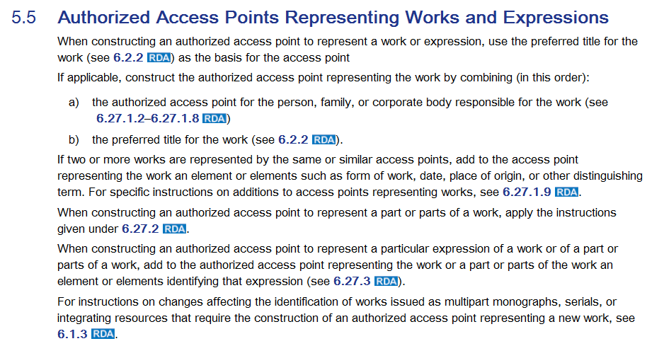

Slide 9
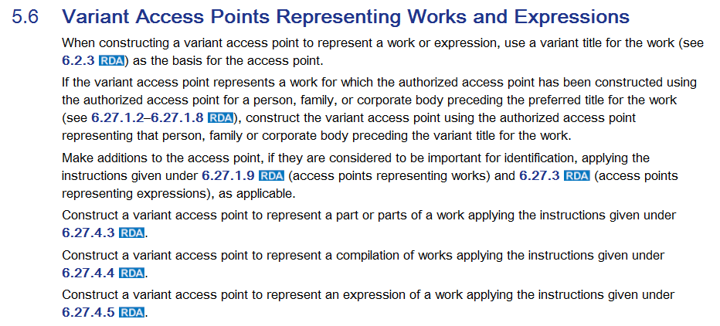

Slide 10
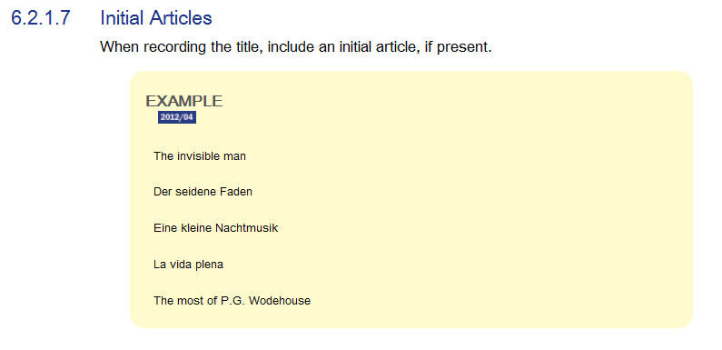
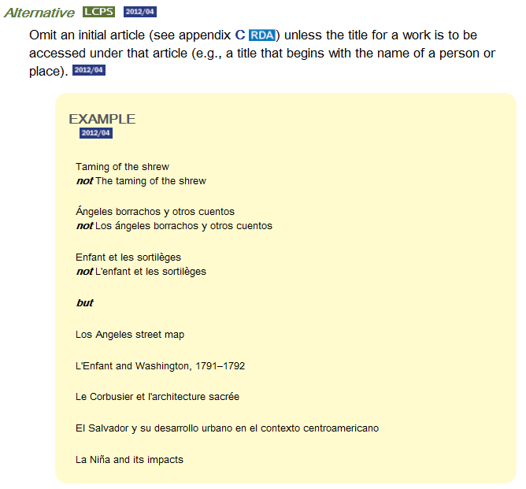
LC-PCC PS for 6.2.1.7.
LC practice for Alternative: Apply the alternative.

Slide 11
Access Points for Works

Slide 12
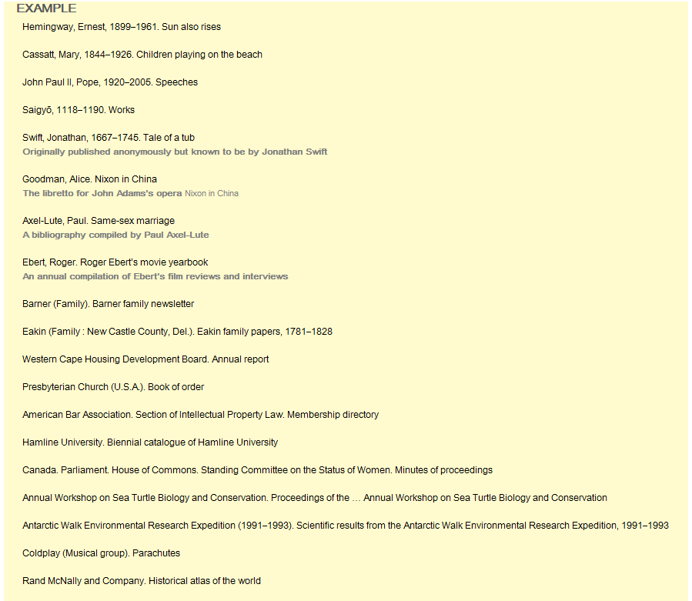
Works Created by One Person, Family, or Corporate Body

Slide 13
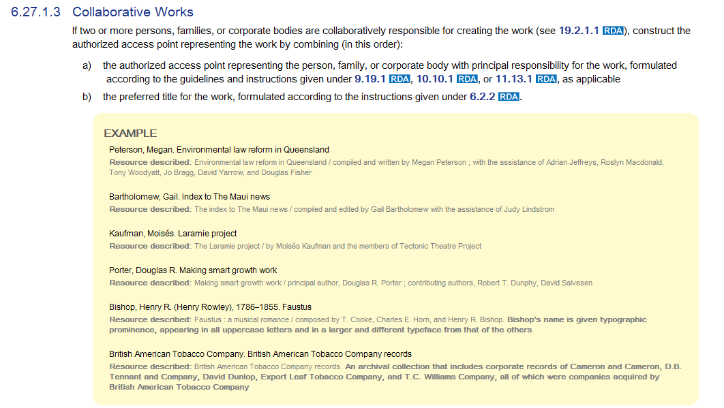
Combine authorized access point for entity with principal responsibility with the preferred title for the work

Slide 14
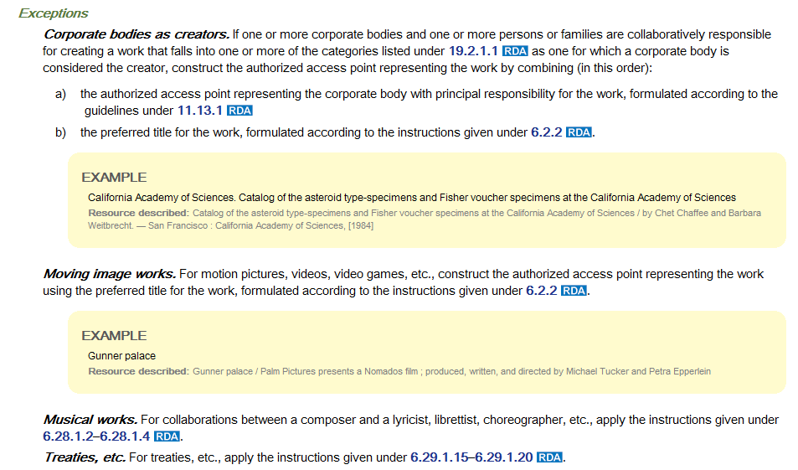
For moving image works the authorized access point is constructed using the preferred title only (and additions to distinguish it from other works with the same preferred title)

Slide 15
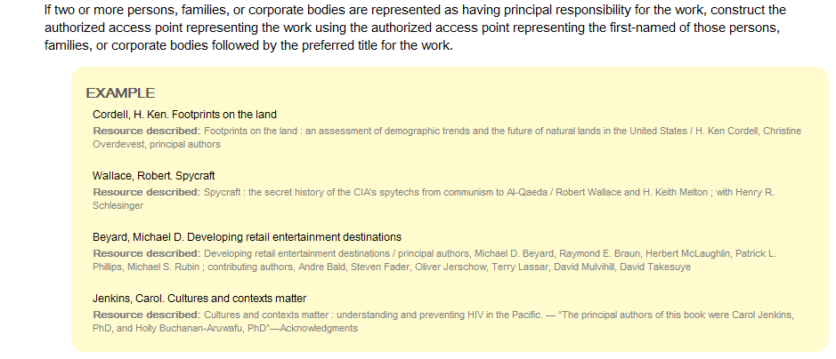
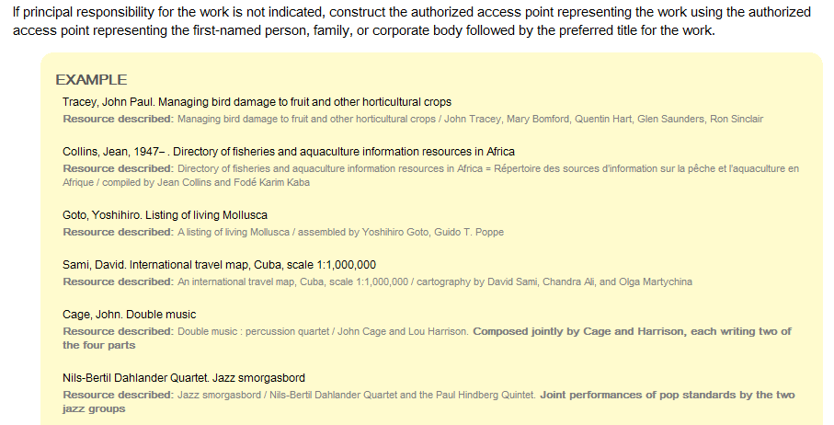
If more than one entity has principal responsibility, use the first-named of the entities in the authorized access point for the work
If more than one entity is involved, but no entity has principal responsibility, use the first-named entity in the authorized access point

Slide 16
Corporate Bodies as Creators
19.2.1.1.1 Corporate bodies are considered to be creators when they are responsible for originating, issuing, or causing to be issued, works that fall into one or more of the following categories:
a) works of an administrative nature dealing with any of the following aspects of the body itself:
i) its internal policies, procedures, finances, and/or operations or
ii) its officers, staff, and/or membership (e.g., directories) or
iii) its resources (e.g., catalogues, inventories)
b) works that record the collective thought of the body (e.g., reports of commissions, committees; official statements of position on external policies, standards)
c) works that report the collective activity of
i) a conference (e.g., proceedings, collected papers) or
ii) an expedition (e.g., results of exploration, investigation) or
iii) an event (e.g., an exhibition, fair, festival, hearing) falling within the definition
of a corporate body (see 18.1.2)
provided that the conference, expedition, or event is named in the resource being described
Notes:
Hearings were added to 19.2.1.1.1 c) iii) in November 2011. This was a change from AACR2, and it made hearings named corporate bodies. However, there is a proposal (6JSC/ALA/15) to be considered by the JSC in November 2012 that will delete hearings from c) iii) and create an entirely new category for “works that record hearings conducted by legislative, governmental, and other bodies.” If approved, as it appears it will be, the creator of a hearing will be, as in AACR2, the body that held the hearing. Hearings themselves would not be considered to be named entities.

Slide 17
Corporate Bodies as Creators
19.2.1.1.1 Corporate bodies are considered to be creators when they are responsible for originating, issuing, or causing to be issued, works that fall into one or more of the following categories:
d) works that result from the collective activity of a performing group as a whole where the responsibility of the group goes beyond that of mere performance, execution, etc.
e) cartographic works originating with a corporate body other than a body that is merely responsible for their publication or distribution
f) legal works of the following types:
i) laws of a political jurisdiction ii) decrees of a head of state, chief executive, or ruling executive body iii) bills and drafts of legislation iv) administrative regulations, etc. v) constitutions, charters, etc. vi) court rules vii) treaties, international agreements, etc. viii) charges to juries, indictments, court proceedings, and court decisions
g) named individual works of art by two or more artists acting as a corporate body.
Notes:
Category g) was added to RDA in November 2011. While a change from AACR2, it was already a category included in the LCRIs, so it doesn’t actually reflect any change in NACO practice.

Slide 18
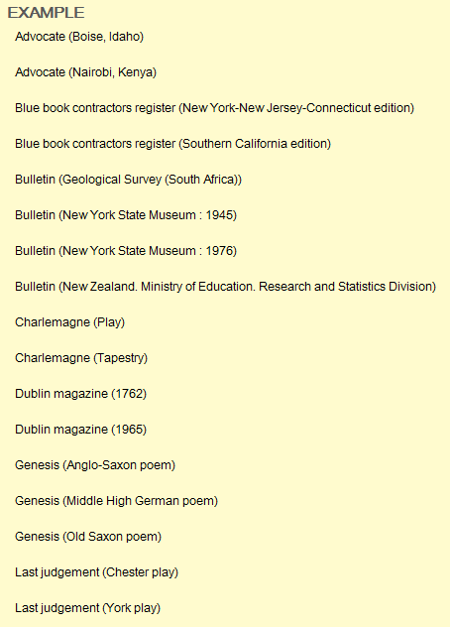
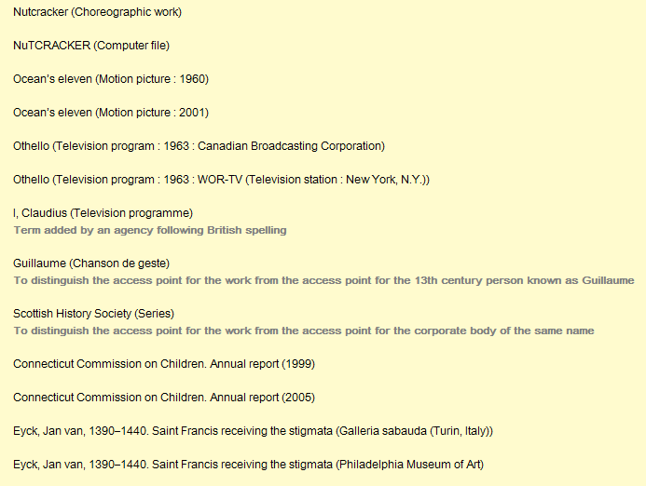

Slide 19
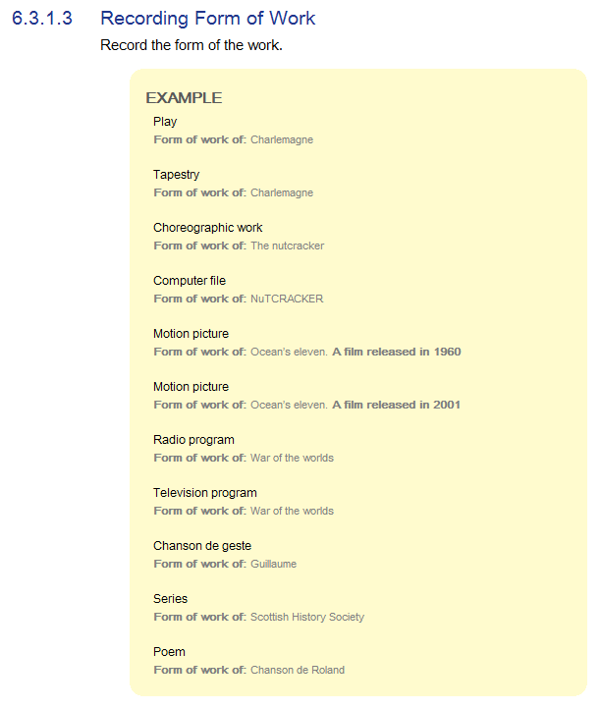
6.3 Form of Work
War of the worlds (Radio program)
War of the worlds (Television program)
21 Jump Street (Motion picture)
21 Jump Street (Television program)
Loos, Anita, $d 1893-1981. $t Gentlemen prefer blondes (Play)
Card, Orson Scott. $t Ender in exile (Graphic novel)
Doctor Who (Series)
Notes:
In the final example, the form of work “Series” is for a bibliographic series of books, not for a television series. For that, you would use “Television program”.

Slide 20
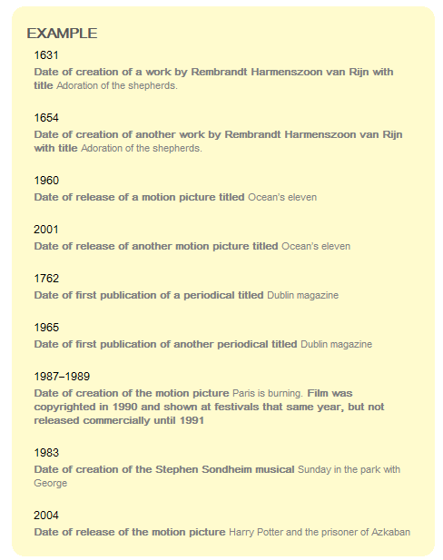
6.4 Date of Work
Rembrandt Harmenszoon van Rijn, $d 1606-1669. $t Adoration of the shepherds (1631)
Rembrandt Harmenszoon van Rijn, $d 1606-1669. $t Adoration of the shepherds (1654)
North Carolina University magazine (1844)
North Carolina University magazine (1852)
War of the worlds (Motion picture : 1953)
Doctor Who (Television program : 1963-1989)
Doctor Who (Television program : 2005- )
Close-up (London, England : 2006)

Slide 21
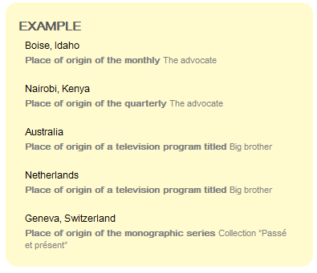
6.5 Place of Origin of Work
History series (Albuquerque, N.M.)
History series (Thibodaux, La.)
Global issues series (New York, N.Y. : 1999)
Big brother (Television program : Australia)
Big brother (Television program : Netherlands)
Antiques roadshow (Television program : Great Britain)
Antiques roadshow (Television program : U.S.)

Slide 22
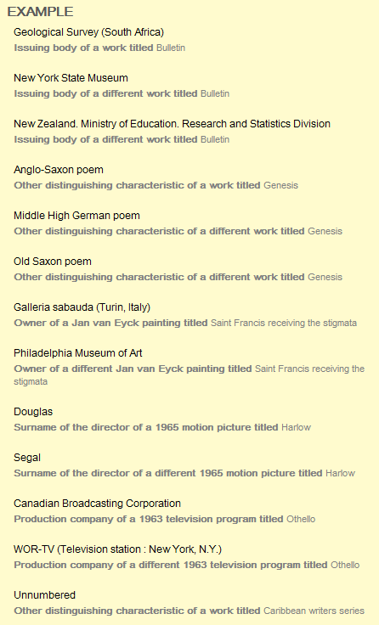
6.6 Other Distinguishing Characteristic of the Work
History series (Huguenot Memorial Museum)
Eyck, Jan van, $d 1390-1440. $t Saint Francis receiving the stigmata (Philadelphia Museum of Art)
War of the worlds (Motion picture : 2005 : Latt)
War of the worlds (Motion picture : 2005 : Spielberg)
Frontline (Television program : Australian Broadcasting Corporation)
Midsummer night's dream (Television program : 1981 : British Broadcasting Corporation)
Strauss, Johann, $d 1825-1899. $t Fledermaus (Pink champagne)
Notes:
“Other distinguishing characteristic of the work” is basically a catchall for anything that doesn’t fit into the other elements that can be added to access points (form of work, date, or place of origin of the work).
Strauss example: this is an adaptation that is considered to be a new work, but is named using the title of the original plus the addition of the title of the adaptation:
6.28.1.6 Operas and Other Dramatic Works with New Text and Title
If the text, plot, setting, or other verbal element of a musical work is adapted or if a new text is supplied, and the title has changed, construct the authorized access point representing the work by combining (in this order):
a) the authorized access point representing the original work
b) the title of the adaptation, enclosed in parentheses.

Slide 23
Parts of a Work
6.2.2.9.1 One Part
Record the preferred title for the part applying the basic instructions on recording titles of works given under 6.2.1.
King of the hill
Preferred title for a part of the television program The Simpsons

Slide 24
Parts of a Work – One Part
6.2.2.9.1
If the part is identified only by a general term (with or without a numeric or alphabetic designation) such as
Preface; Detail (for an image, etc.); Epilogue;
Book 1; Part 2; Number 1; Band 3
record the designation of the part as the preferred title for the part. Record the numeric designation as a numeral.
Season 6
Preferred title for a part of the television program Buffy, the vampire slayer
1946-03-10
Preferred title for a part of the radio program Jack Benny program

Slide 25
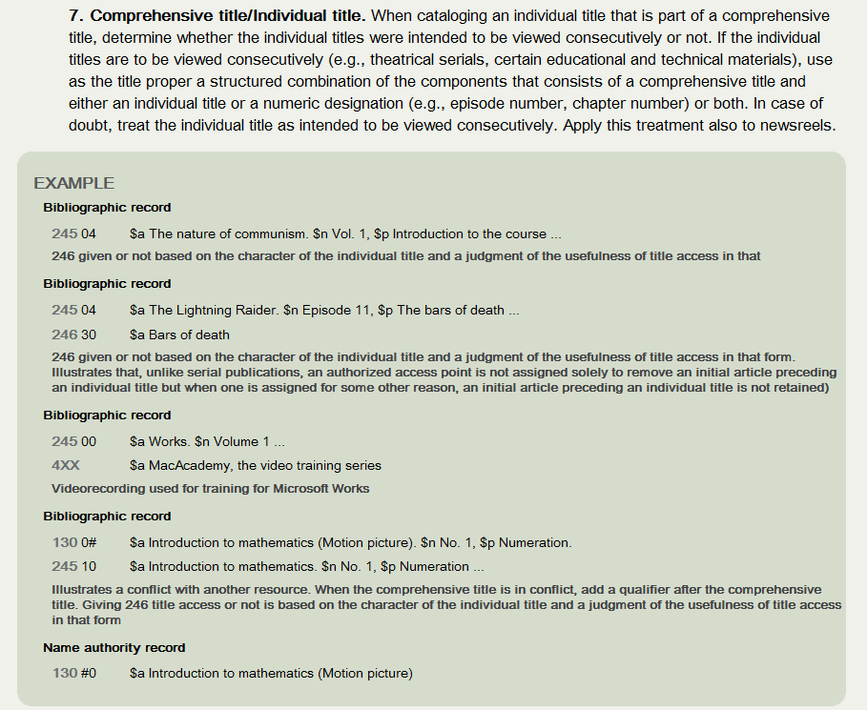
LC-PCC PS for 6.27.1.9 Appendix 1 – Motion Pictures

Slide 26
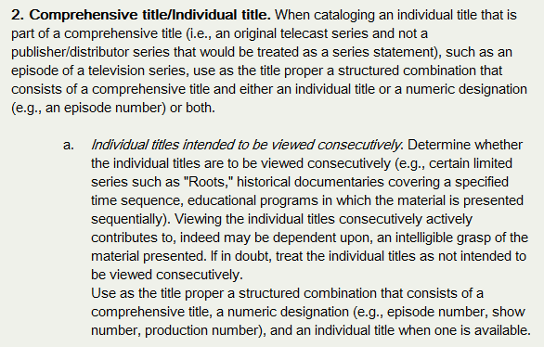
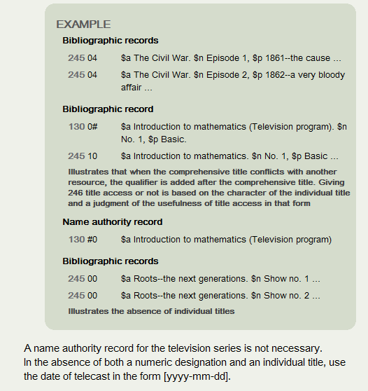
LC-PCC PS for 6.27.1.9 Appendix 1 – Television Programs

Slide 27
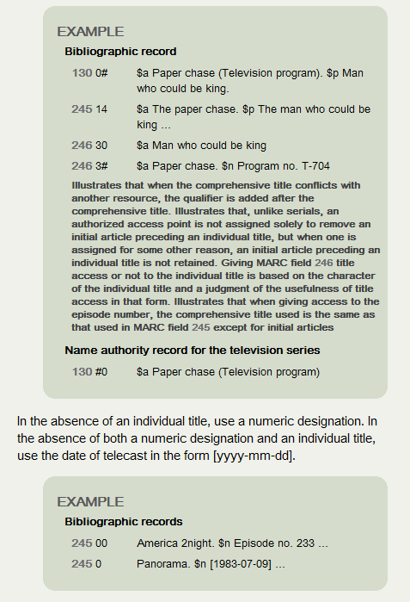
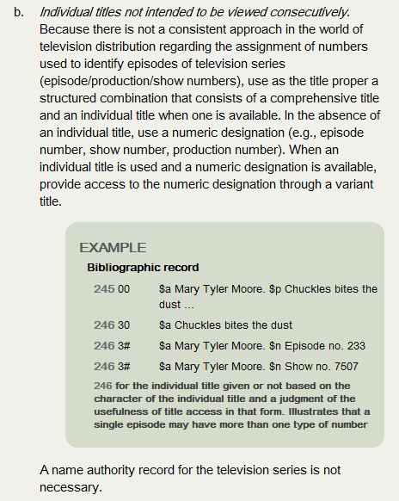
LC-PCC PS for 6.27.1.9 Appendix 1 – Television Programs

Slide 28
Parts of a Work – Two or More Parts
6.2.2.9.2
For a sequence of two or more consecutively numbered parts of a work, each of which is identified only by a general term and a number, record the designation of the parts in the singular followed by the inclusive numbers of the parts recorded as numerals.
Episode 1-4
Preferred title for the first four episodes of the 1977 television miniseries Roots

Slide 29
Parts of a Work – Two or More Parts
6.2.2.9.2
When identifying two or more unnumbered or non-consecutively numbered parts of a work, record the preferred title for each of the parts applying the instructions given under 6.2.2.9.1.
Alternative
When identifying two or more unnumbered or non-consecutively numbered parts of a work, instead of (or in addition to) recording the preferred title for each of the parts, record the conventional collective title Selections as the preferred title for the parts.
Selections
Preferred title for the parts of the work in a compilation comprising four episodes of the television program The Simpsons originally broadcast between 1990 and 2001
LC-PCC PS for Alternative: LC practice: Instead of recording the preferred title for each of the parts, record the conventional collective title Selections as the preferred title for the parts. If one or more parts is especially important, also record the part title(s).

Slide 30
Access Points for Parts of a Work

Slide 31
Access Points for Parts of a Work

Slide 32
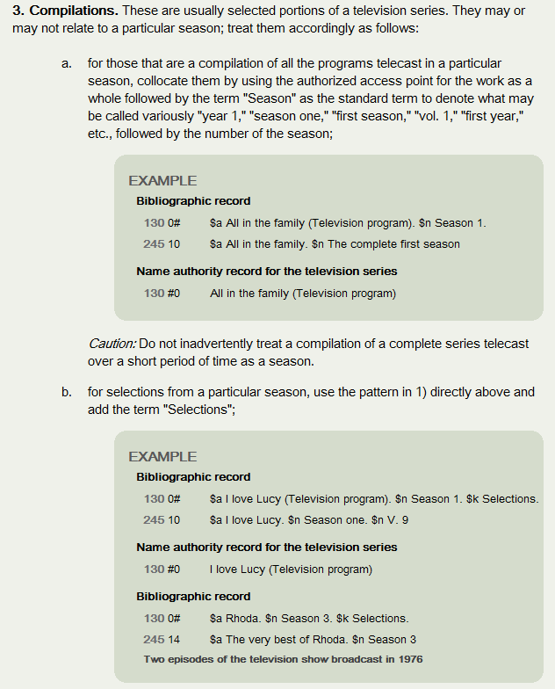
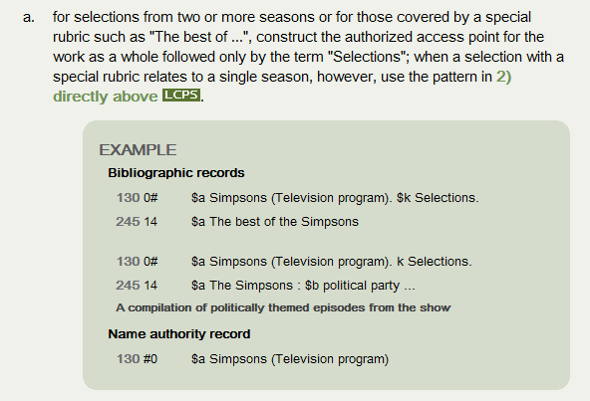
c.
LC-PCC PS for 6.27.1.9 Appendix 1 – Television Programs

Slide 33
Access Points for Expressions

Slide 34
Expression Core Elements (5.3)
When recording data identifying an expression, include as a minimum the elements listed below that are applicable and readily ascertainable.
Identifier for the expression
Content type MARC Bibliographic/Authority 336
Language of expression MARC Bibliographic/Authority 377
Record as many of the additional identifying elements listed below as necessary to differentiate one expression of a work from another. Record the elements either as additions to the access point representing the expression, as separate elements, or as both.
Date of expression MARC Bibliographic/Authority 046 $k $l
Other distinguishing characteristic of the expression
MARC Bibliographic/Authority 381
When describing a cartographic expression, include as a minimum the elements listed below that are applicable and readily ascertainable.
Horizontal scale of cartographic content MARC Bibliographic 255
Vertical scale of cartographic content MARC Bibliographic 255

Slide 35
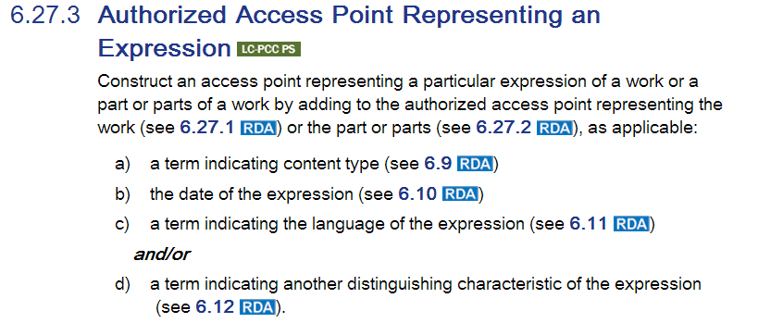
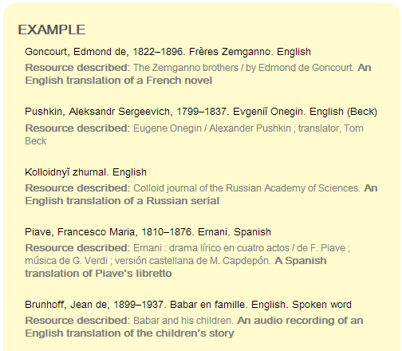
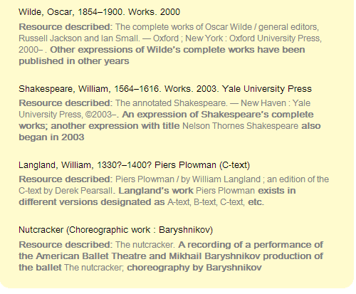
Notes:
LC-PCC PS for 6.27.3. LC practice: Identify expressions by adding an expression attribute to the authorized access point for the work in the following situations:
1. music resources (see RDA 6.28.3); 2. sacred scriptures (see RDA 6.30.3); 3. translations (see below) 4. language editions (see below)
When identifying an expression not already represented by a name authority record, do not add another characteristic to differentiate one such expression from another expression (e.g., do not differentiate one translation of Shakespeare’s Hamlet in French from another French translation; do not differentiate one arrangement of Berlioz’ Corsaire from another arrangement). Other elements in LC’s bibliographic record (e.g., translator, date, medium of performance) are available to the user for selecting a specific expression if desired; RDA 0.6.3 allows differentiating characteristics to be recorded as separate elements or as part of the authorized access points. If there is a name authority record with an authorized access point for an expression that includes an additional characteristic LC would not have added, use the form of the access point in that authority record; this action is consistent with the LC/PCC policy of using authorized access points in existing name authority records.
PCC practice: Pending outcome of report/recommendations from the PCC Access Point for Expressions Task Group
Translations
Identify an expression in a language different from that of the original expression by adding the name of the language in subfield $l to the authorized access point for the work.
When the original expression and one translation are in a compilation, give an analytical authorized access point for each expression. If a compilation contains the original expression and more than one translation, give analytical authorized access points for the original expression and at least one translation.
Language Editions
When cataloging a language edition other than the one designated as the original edition, identify the expression by adding the name of the language in subfield $l to the authorized access point for the work. See LC-PCC PS 6.2.2.4 for the instruction on choosing the preferred title for the work.
When two language editions are in a compilation, provide analytical authorized access points for each expression. If a compilation contains more than two language editions, give analytical authorized access points for the original edition and at least one other edition. If the original edition has not already been selected on the basis of one of the editions having been received earlier (see LC-PCC PS 6.2.2.4), select the first one in the compilation as the original edition for purposes of choosing the preferred title for the work.

Slide 36
6.9 Content Type
cartographic dataset | computer dataset | spoken word | tactile three-dimensional form
cartographic image | computer program | still image | text
cartographic moving image | notated movement | tactile image | three-dimensional form
cartographic tactile image | notated music | tactile notated movement | three-dimensional moving image
cartographic tactile three-dimensional form | performed music | tactile notated music | two-dimensional moving image
cartographic three-dimensional form | sounds | tactile text
Shostakovich, Dmitriĭ Dmitrievich, $d 1906-1975. $t Symphonies, $n no. 11, op. 103, $r G minor. $h Performed music
Schubert, Franz, $d 1797-1828. $t An die Leier. $l Italian. $h Performed music
Bradley, C. Alan, $d 1938- $t Flavia de Luce mystery. $h Spoken word
Notes:
6.9 Content Type (MARC 336 and/or $h in access points)
The form of communication through which a work is expressed. Field 336 information enables expression of content types from various lists when the authority is for a title or name/title.
In bib. records, the content type would be added in $h. $h is currently not permitted in NACO authority records, so catalogers have used $s (Version) instead.
In the examples in this slide, text in black is the authorized access point representing the work.

Slide 37
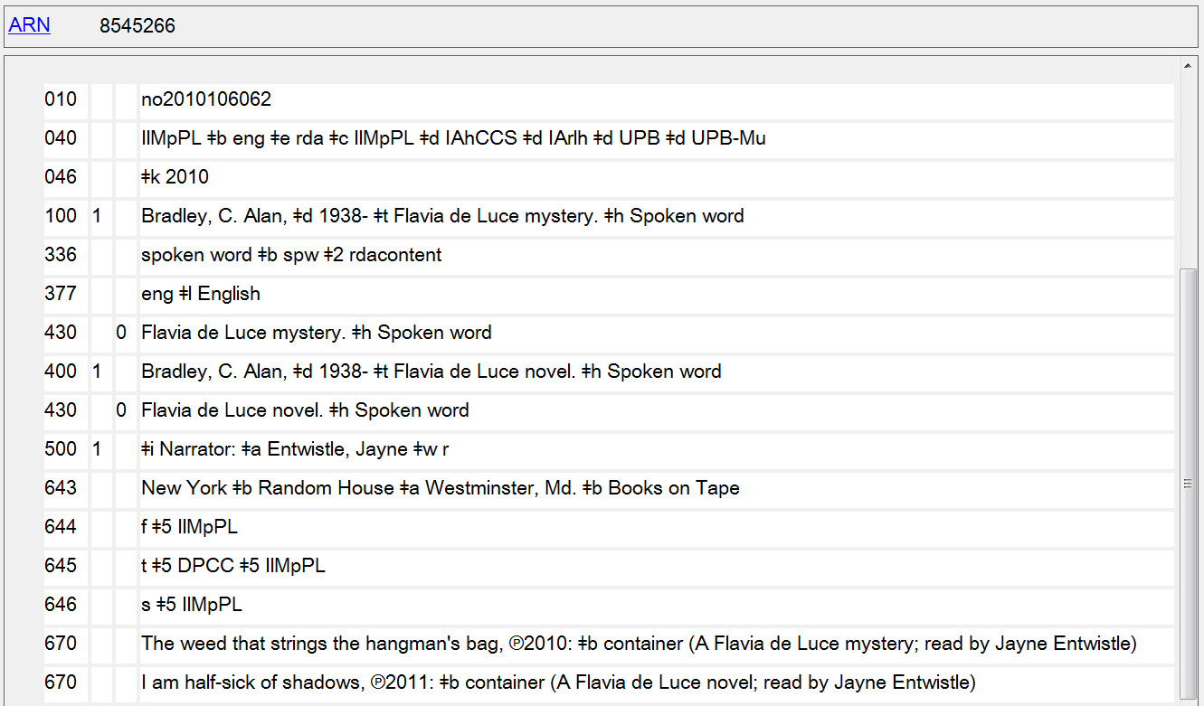

Slide 38
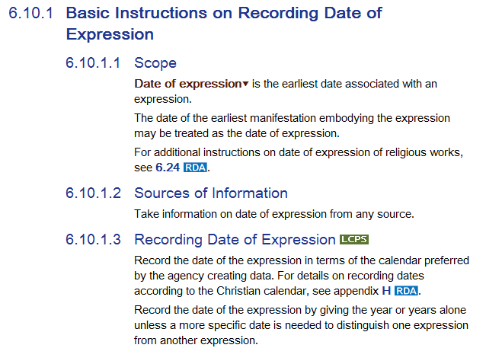
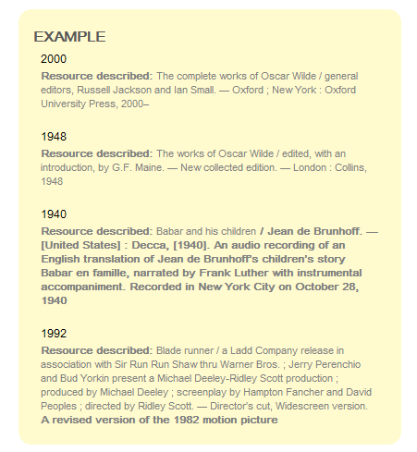
6.10 Date of Expression
Schnitzler, Arthur, $d 1862-1931. $t Works. $f 2012
Samutina, Hanna, $d 1929- $t Works. $k Selections. $f 2011
Twain, Mark, $d 1835-1910. $t Adventures of Huckleberry Finn. $h Spoken word. $f 2000
Pushkin, Aleksandr Sergeevich, $d 1799-1837. $t Evgeniĭ Onegin. $l English $s (Arndt : $f 1978)
Notes:
046 $k and $l can be used to record the element separately if desired.
Twain, Mark, $d 1835-1910. $t Adventures of Huckleberry Finn. $h Spoken word. $f 2000 – this expression is read by Jack Lemmon – however, date might not be the best addition; perhaps the surname of the reader would be better
Pushkin, Aleksandr Sergeevich, $d 1799-1837. $t Evgeniĭ Onegin. $l English $s (Arndt : $f 1978) – there are two English expressions of Pushkin’s work by Walter Arndt; the first was published in 1963; in 1978 an extensively revised version was completed, which wasn’t published until 1981
In the examples in this slide, text in black is the authorized access point representing the work.

Slide 39
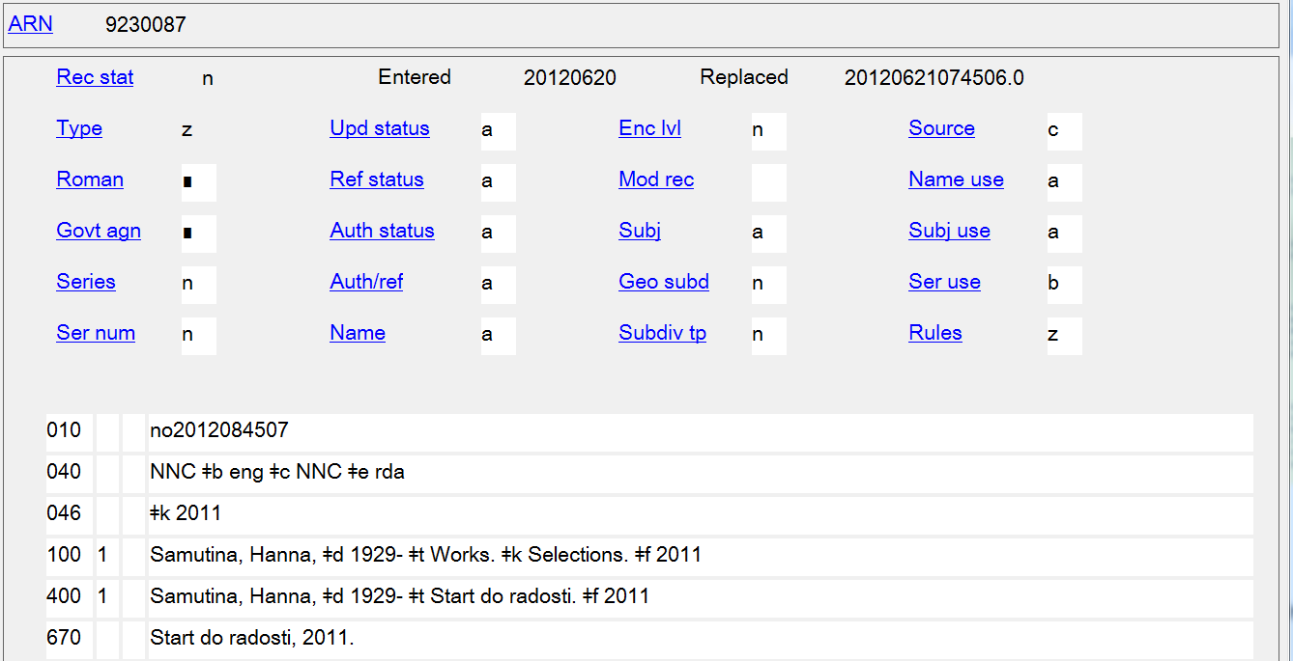

Slide 40
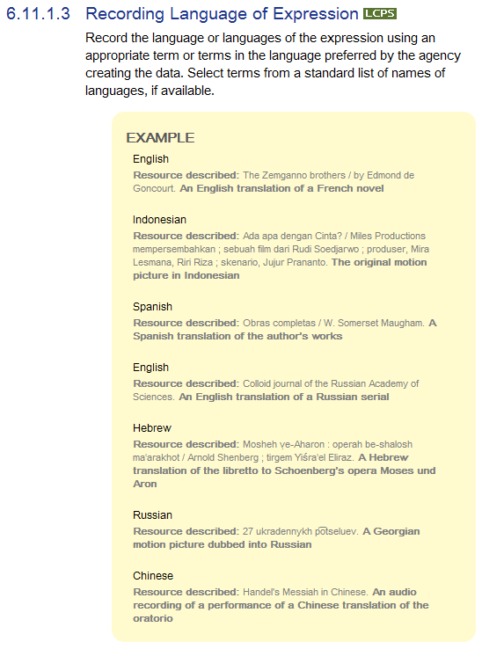
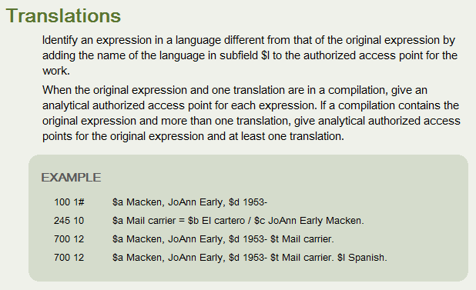
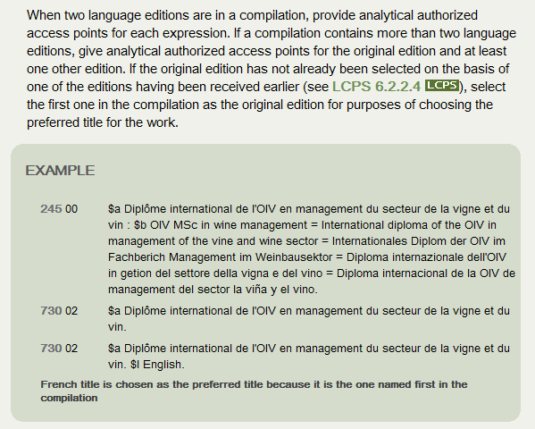
6.11 Language of Expression
LC-PCC PS for 6.27.3
Notes:
LC-PCC PS for 6.27.3
Translations
Identify an expression in a language different from that of the original expression by adding the name of the language in subfield $l to the authorized access point for the work.
When the original expression and one translation are in a compilation, give an analytical authorized access point for each expression. If a compilation contains the original expression and more than one translation, give analytical authorized access points for the original expression and at least one translation.
EXAMPLE
100 1# $a Macken, JoAnn Early, $d 1953-
245 10 $a Mail carrier = $b El cartero / $c JoAnn Early Macken.
700 12 $a Macken, JoAnn Early, $d 1953- $t Mail carrier.
700 12 $a Macken, JoAnn Early, $d 1953- $t Mail carrier. $l Spanish.
Language Editions
When cataloging a language edition other than the one designated as the original edition, identify the expression by adding the name of the language in subfield $l to the authorized access point for the work. See Policy Statement 6.2.2.4 for the instruction on choosing the preferred title for the work.
EXAMPLE
130 0# $a Revista de política y derecho ambientales en América Latina y el Caribe. $l English.
245 10 $a Journal of environmental policy and law in Latin America and the Caribbean.
Spanish title is chosen as the preferred title because it was the first one received
When two language editions are in a compilation, provide analytical authorized access points for each expression. If a compilation contains more than two language editions, give analytical authorized access points for the original edition and at least one other edition. If the original edition has not already been selected on the basis of one of the editions having been received earlier (see Policy Statement 6.2.2.4), select the first one in the compilation as the original edition for purposes of choosing the preferred title for the work.
EXAMPLE
245 00 $a Diplôme international de l'OIV en management du secteur de la vigne et du vin : $b OIV MSc in wine management = International diploma of the OIV in management of the vine and wine sector = Internationales Diplom der OIV im Fachberich Management im Weinbausektor = Diploma internazionale dell'OIV in getion del settore della vigna e del vino = Diploma internacional de la OIV de management del sector la viña y el vino.
730 02 $a Diplôme international de l'OIV en management du secteur de la vigne et du vin.
730 02 $a Diplôme international de l'OIV en management du secteur de la vigne et du vin. $l English.
French title is chosen as the preferred title because it is the one named first in the compilation

Slide 41
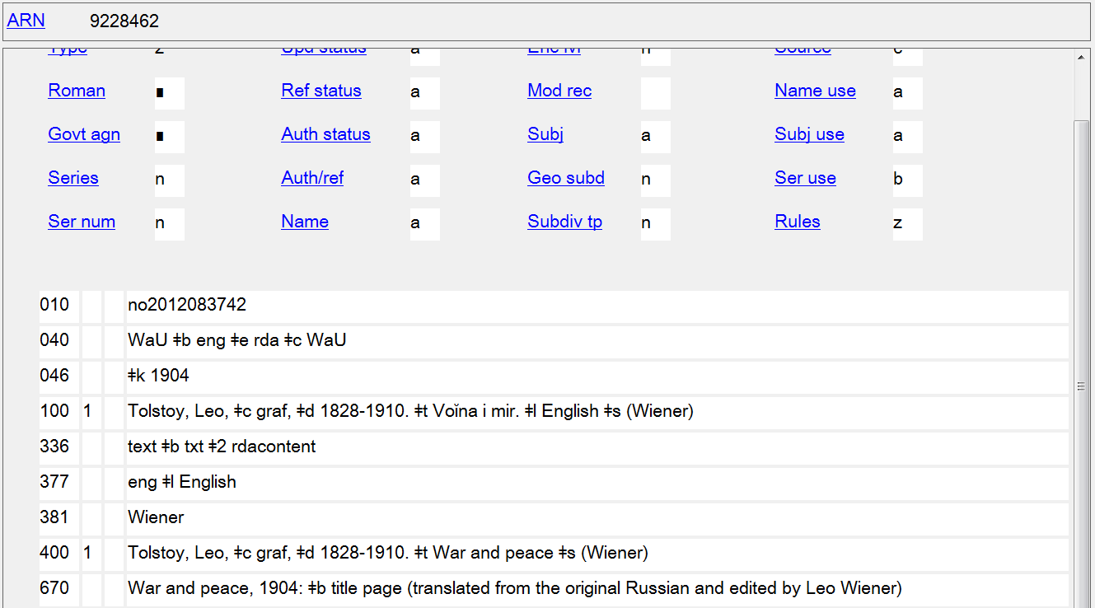

Slide 42
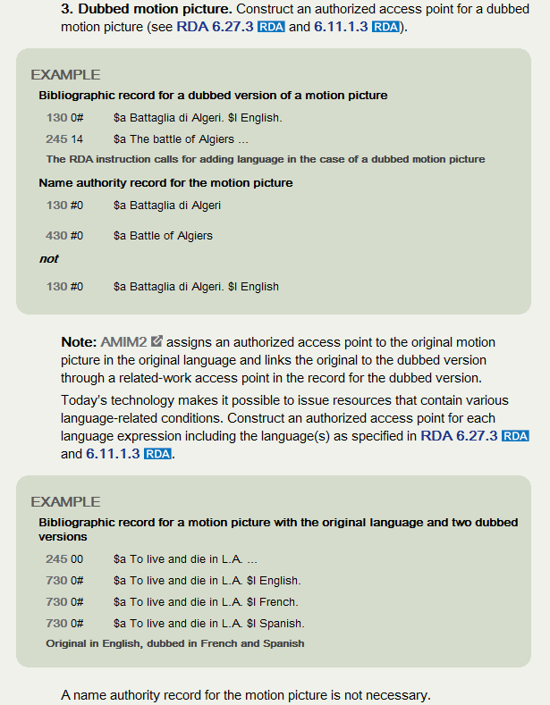
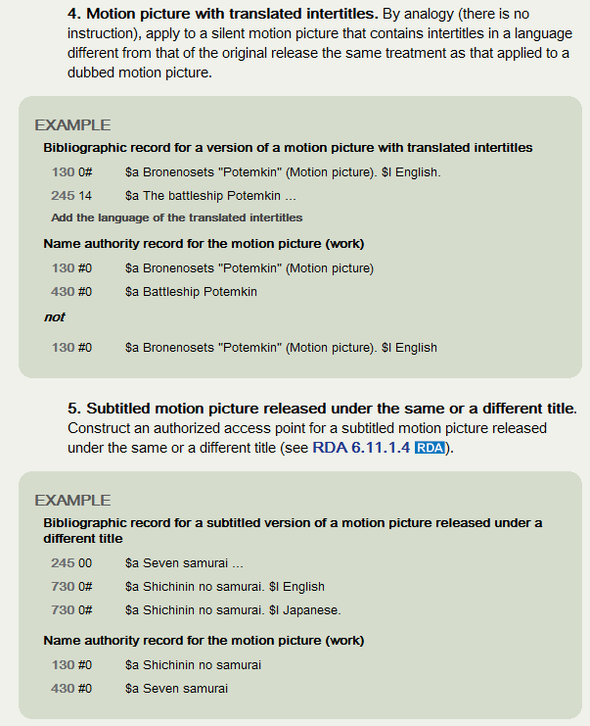
LC-PCC PS for 6.27.1.9 Appendix 1
Notes:
LC-PCC PS for 6.27.1.9 Appendix 1

Slide 43
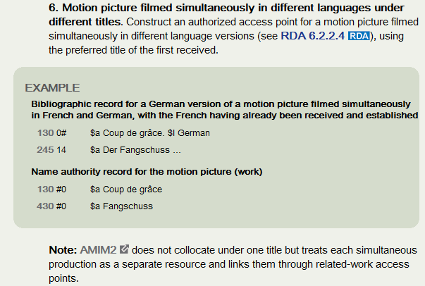
AACR2 Bibliographic Record
130 0_ $a Lola rennt (Motion picture). $l English & German.
130 0_ $a Spirit, stallion of the Cimarron (Motion picture). $l Polyglot
RDA Bibliographic Record
730 02 $a Lola rennt (Motion picture)
730 02 $a Lola rennt (Motion picture). $l English
730 02 $a Spirit, stallion of the Cimarron (Motion picture)
730 02 $a Spirit, stallion of the Cimarron (Motion picture). $l French
730 02 $a Spirit, stallion of the Cimarron (Motion picture). $l Spanish
Notes:
The first example has the original German language track and a language track in English. The English name for this film is Run Lola Run.
The second example has the original English language track and dubbed versions in French and Spanish.
In the RDA examples in this slide, text in black is the authorized access point representing the work.

Slide 44
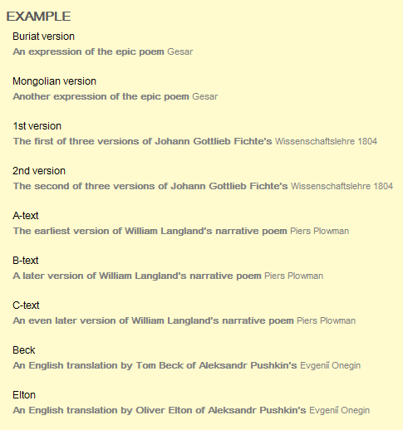
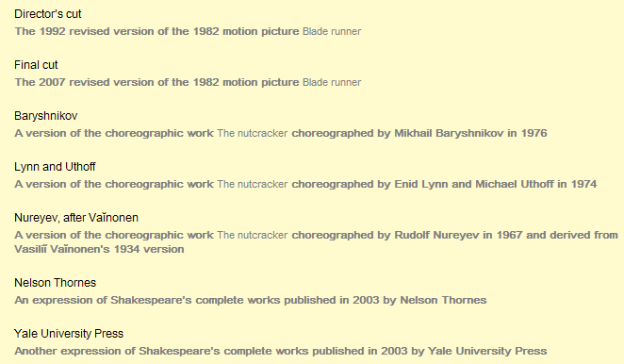
6.12 Other Distinguishing Characteristic of the Expression

Slide 45
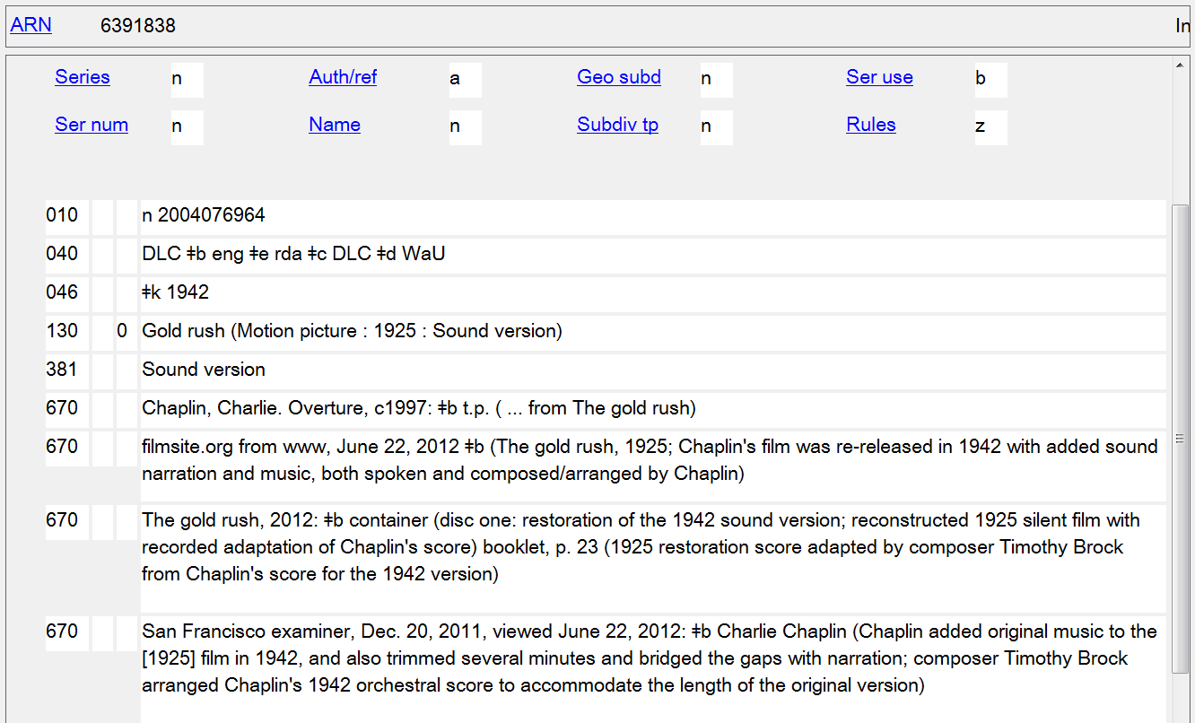

Slide 46
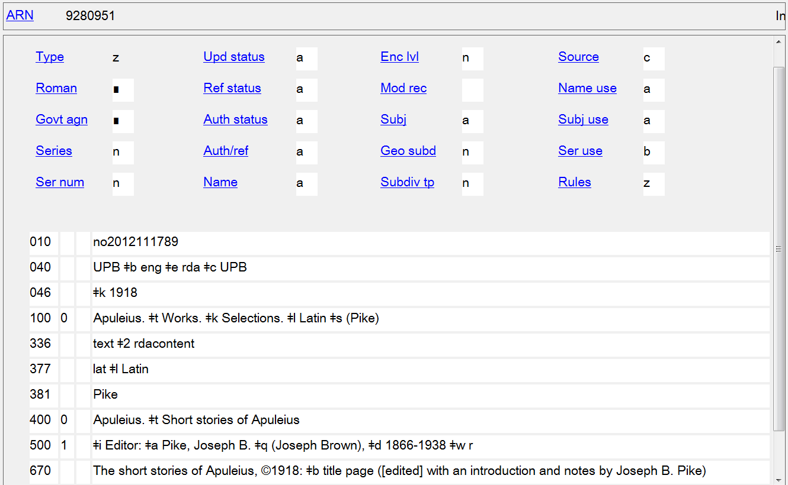

Slide 47
6.12 Other Distinguishing Characteristic of the Expression
Gold rush (Motion picture : 1925 : Sound version)
Blade runner (Motion picture : Director's cut)
Blade runner (Motion picture : Final cut)
Pushkin, Aleksandr Sergeevich, $d 1799-1837. $t Evgeniĭ Onegin. $l English $s (Hofstadter)
Apuleius. $t Works. $k Selections. $l Latin $s (Pike)
Vivaldi, Antonio, $d 1678-1741. $t Vocal music. $k Selections (Musical Heritage Society)
Twain, Mark, $d 1835-1910. $t Adventures of Huckleberry Finn. $h Spoken word $s (Lemmon)
Notes:
In the examples in this slide, text in black is the authorized access point representing the work or the part(s) of the work.

Slide 48
Note: Expressions of musical, legal, and religious works and official communications have their own instructions
Berlioz, Hector, $d 1803-1869. $t Vocal music. $k Selections; $o arranged
Beethoven, Ludwig van, $d 1770-1827. $t Serenades, $m string trio, $n op. 8, $r D major; $o arranged $s (Urhan)
Good King Wenceslas; $o arranged $s (McDonald)
Carter, Elliott, $d 1908- $t Symphonies, $n no. 1 (Sketches)
Moore, Douglas, $d 1893-1969. $t Works. $k Selections (Sketches)
Handel, George Frideric, $d 1685-1759. $t Messiah. $s Vocal score
Sullivan, Arthur, $d 1842-1900. $t Operas. $s Chorus scores. $k Selections
Schönberg, Claude-Michel. $t Misérables. $l Danish
Handel, George Frideric, $d 1685-1759. $t Messiah. $s Vocal score. $l German
Code of Hammurabi. $l Serbian
Kosovo (Republic). $t Kushtetuta e Republikës së Kosovës. $l English
Córdoba (Spain). $t Fuero (Latin version)
Bolivia. $t Treaties, etc. $g Paraguay, $d 1938 July 21. $l English
Bible. $p Gospels. $l English. $s Revised Standard. $f 1975
Bible. $p Psalms. $l Afrikaans. $s Oberholzer and others. $f 2005
Tosefta. $p Beẓah. $l German
Vedas. $p Sāmaveda (Kauthumasaṃhitā)
Catholic Church. $t Breviary (Ambrosian)
Seder Haḳafot (Spinḳa)
Haggadah (Reform : Seligmann)
Talmud Yerushalmi. $l German. $f 1975
Da zang jing (Koryŏ version)
United States. $b President (1861-1865 : Lincoln). $t Speeches. $l Japanese

Slide 49
Work/Expression Exercises

Slide 50
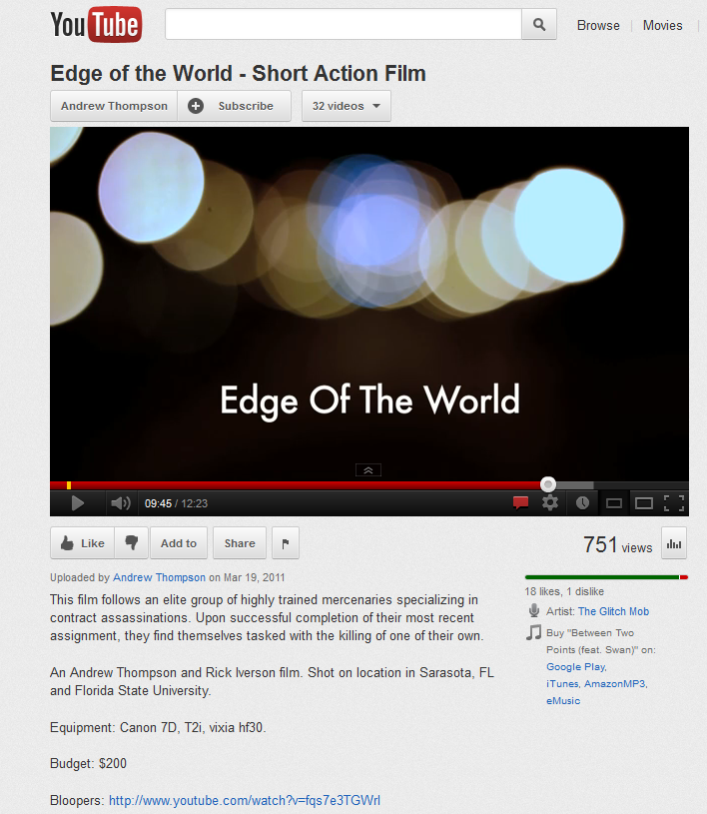
Exercise 1 – Determine authorized access point for this work

Slide 51
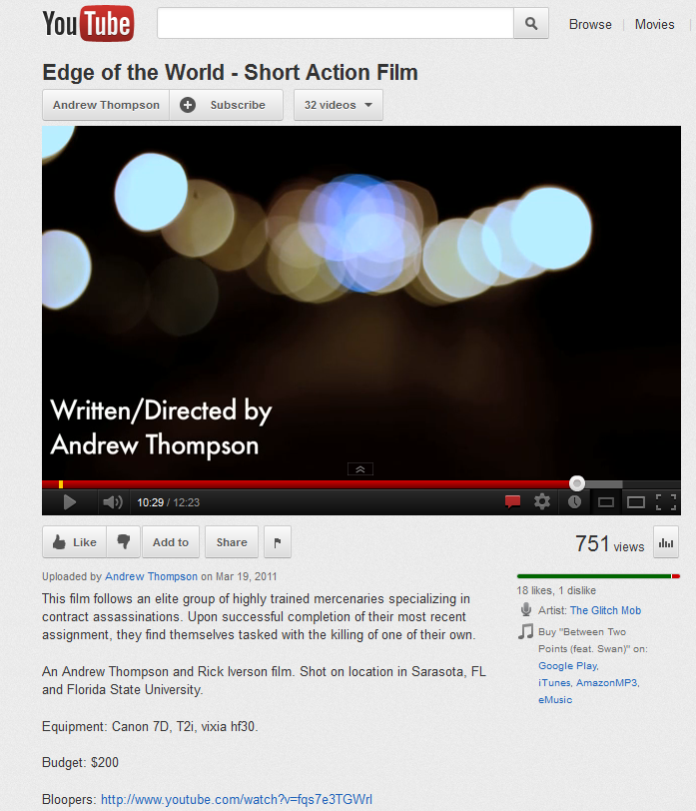

Slide 52
Info you’ve found
Results of a search of the NAF for the title Edge of the world:
100 1_ Anderman, Janusz, $d 1949- $t Kraj świata. $l English
400 1_ Anderman, Janusz, $d 1949- $t Edge of the world
100 1_ Childs, Barney. $t Edge of the world
100 1_ Powell, Michael, $d 1905-1990. $t 200,000 feet on Foula
400 1_ Powell, Michael, $d 1905-1990. $t Edge of the world
130 _0 Edge of the world (Motion picture)
SEE AUTHORITY RECORD ON NEXT PAGE

Slide 53
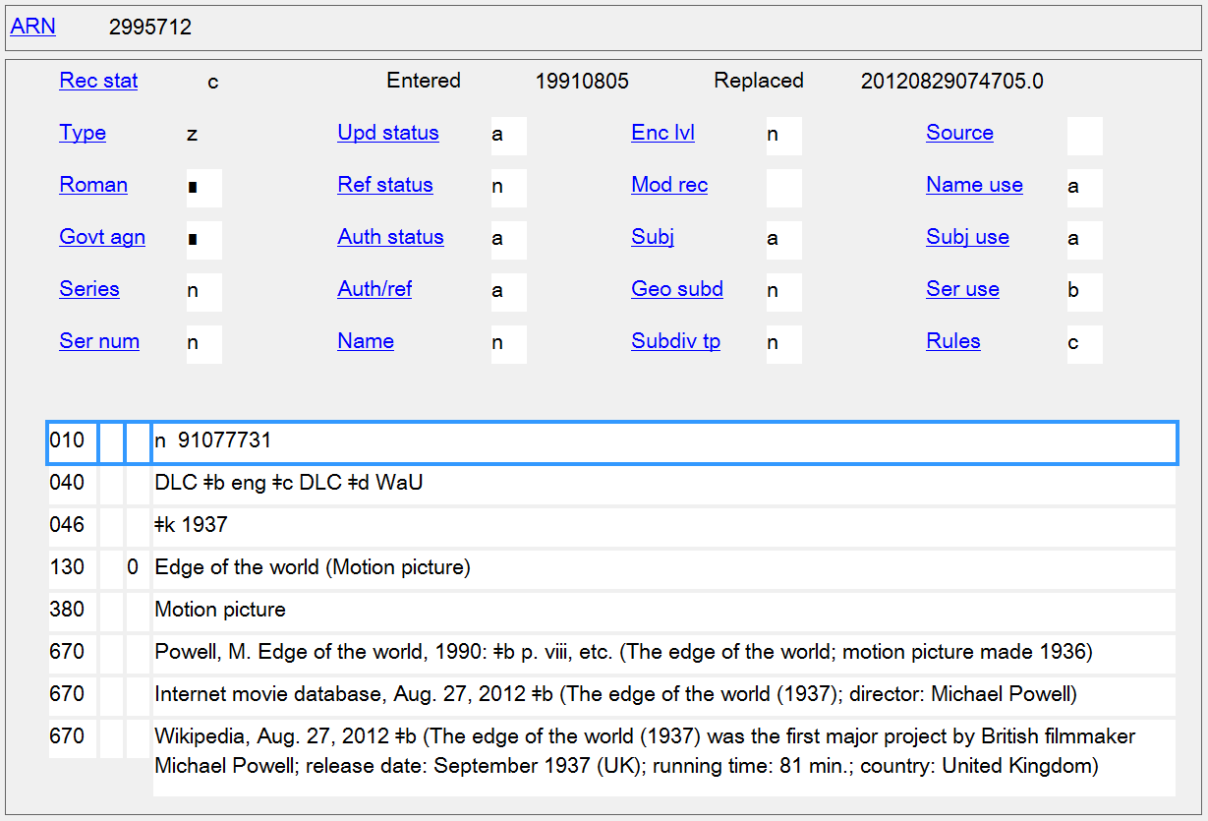

Slide 54
More info you’ve found
Results of IMDb search for Edge of the world:
The Edge of the World (1937)
The Edge of the World (2005)
The Edge of the World (2009)
The Edge of the World: BC’s Early Years (2010)
Edge of the World (2011) SEE SCREENSHOT FROM IMDb
The Edge of the World (2011) SEE SCREENSHOT FROM IMDb

Slide 55
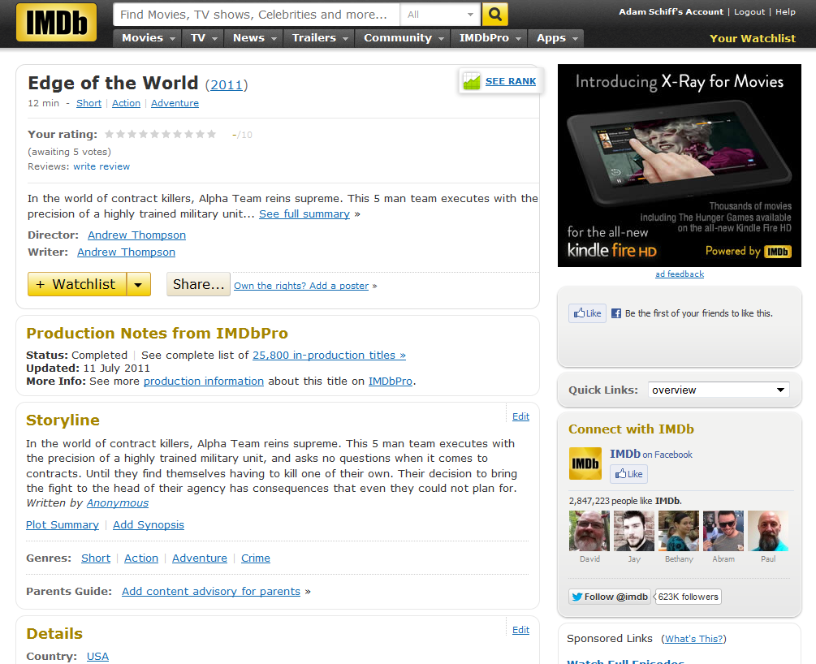

Slide 56
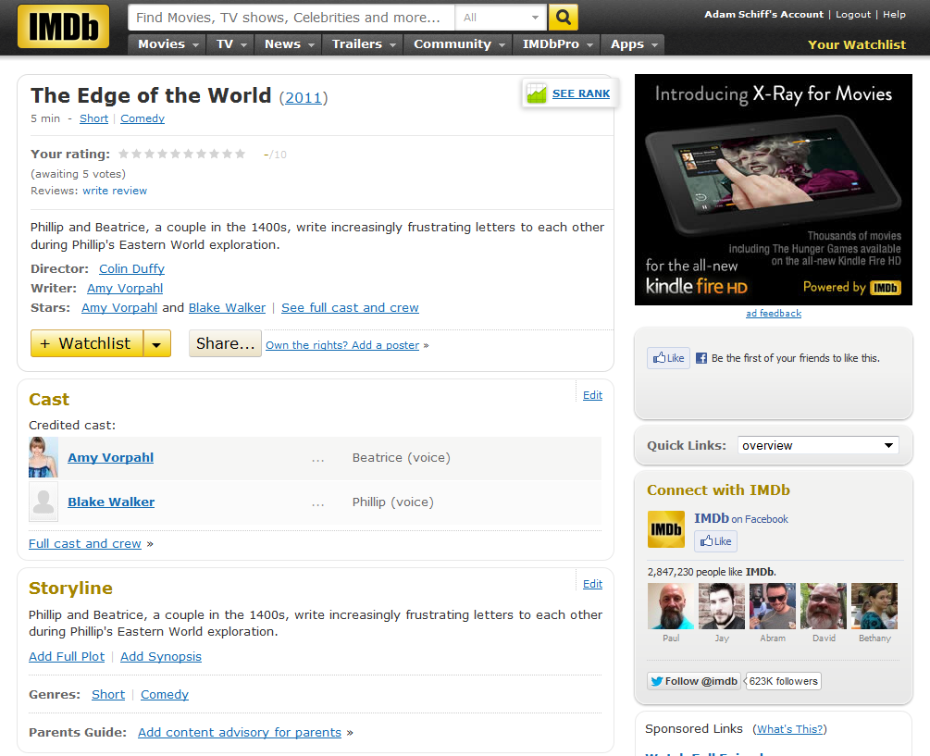

Slide 57
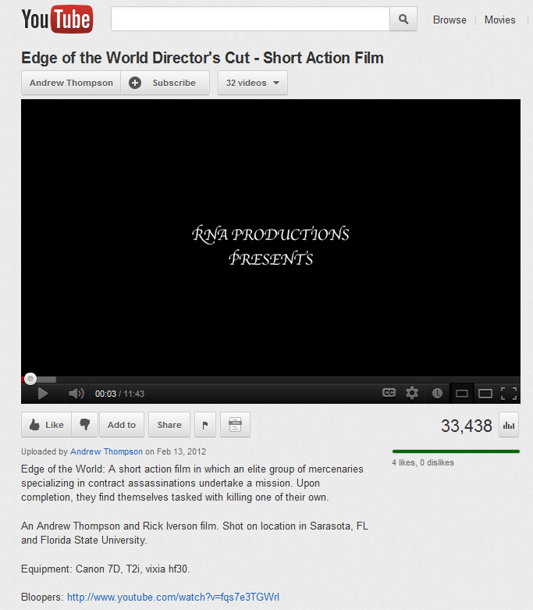
Exercise 2 – Determine authorized access point for this resource

Slide 58
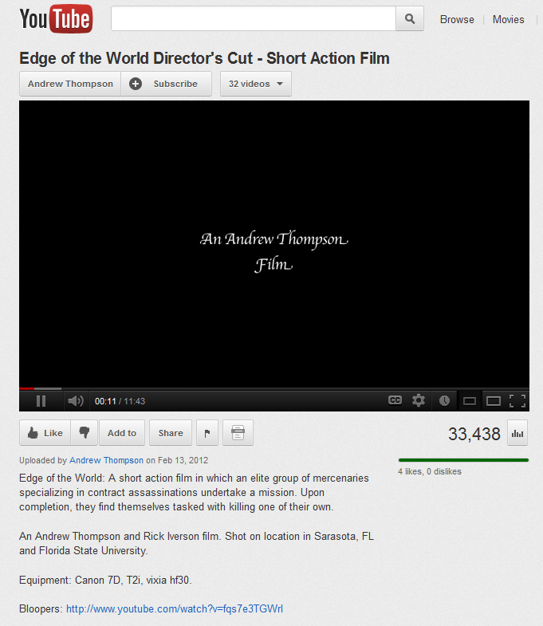

Slide 59
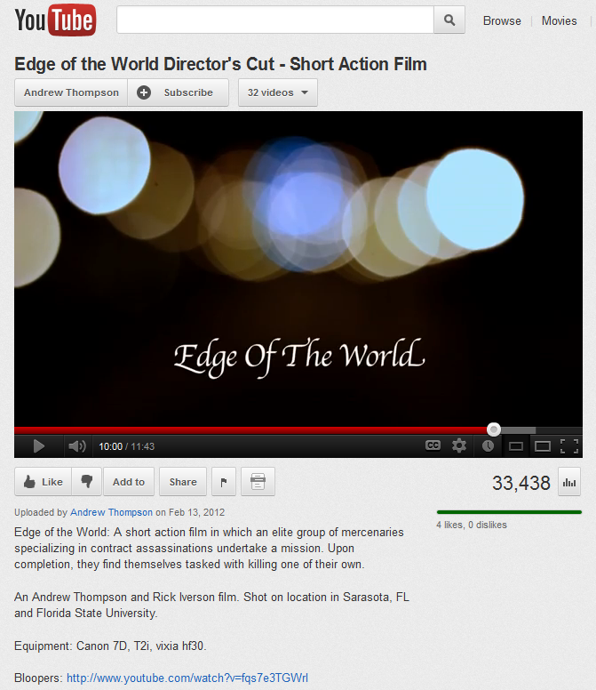

Slide 60
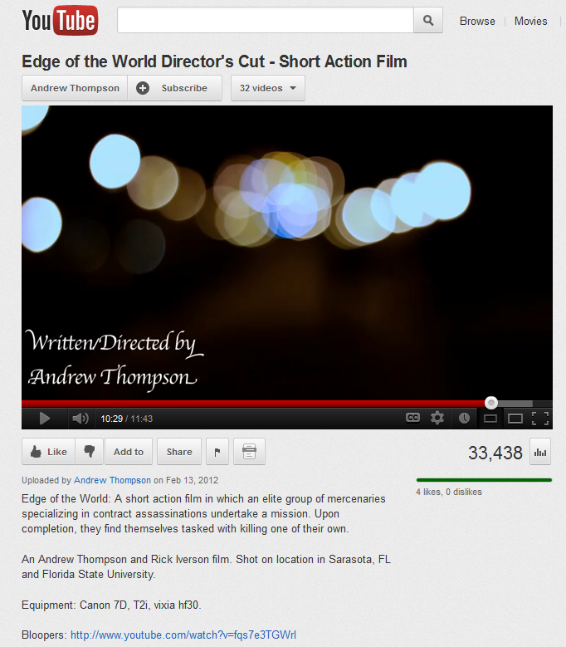

Slide 61
Exercise 3 – Determine the authorized access point(s) for expressions of this resource

Slide 63
LANGUAGES: ENGLISH, FRENCH (Doublé au Québec), SPANISH, THAI 5.1 Dolby Digital, ENGLISH - Audio Description Track Dolby Surround
SUBTITLES: ENGLISH, ENGLISH SDH, FRENCH, SPANISH, CHINESE, KOREAN, THAI

Slide 64
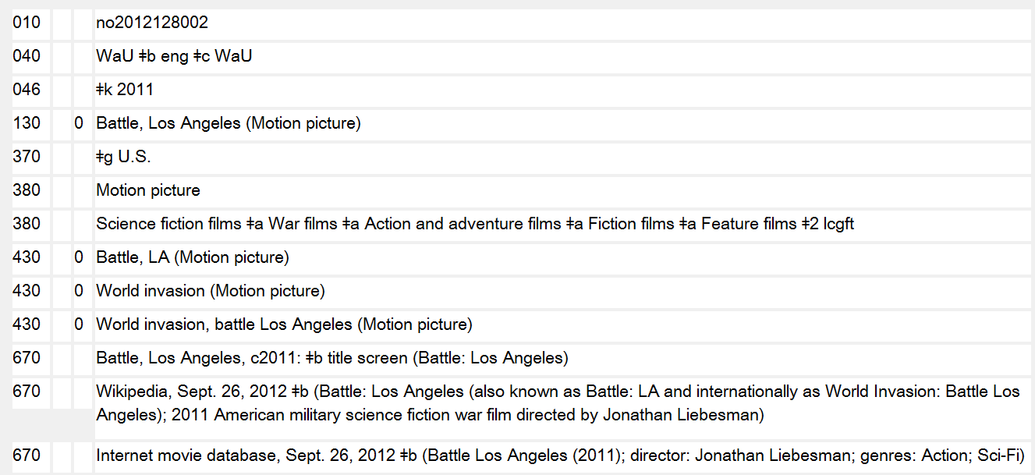

Slide 65
Exercise 4a – Determine the authorized access point for the part of the work
Authority record found for the work:
130 _0 Glee (Television program)

Slide 66
Exercise 4b – Determine the authorized access point for the part of the work
Authority record found for the work:
130 _0 Good wife
(Television
program)
SEE ALSO INFO FROM EPGUIDES.COM ON NEXT SLIDE

Slide 68
Exercise 5a – Determine the authorized access point for this work
Authority records found for entities related to this resource:
100 1_ Foster, Leslie T., $d
1947-
100 1_ Keller, C. Peter
100 1_ Boomer, Jack
110 2_ Western Geographical
Press
110 2_ University of Victoria
(B.C.). $b Department
of Geography

Slide 69
Exercise 5b – Determine the authorized access point for this work
Authority records found for entities related to this resource:
100 1_ Shaw, Mary, $d 1968-
100 1_ Thomas, Bethan
100 1_ Boomer, Jack
100 1_ Smith, George Davey
100 1_ Dorling, Daniel
110 2_ Policy Press

Slide 70
Exercise 5c – Determine the authorized access point for this work
Authority records found for entities related to this resource:
110 1_ Canada. $b Indian and
Northern Affairs Canada
100 1_ Anderson, Erik, $d 1966-
110 2_ Public History Inc.
100 1_ Bonesteel, Sarah

Slide 71
Exercise 5d – Determine the authorized access point for this work
Authority records found for entities related to this resource:
100 1_ Kelleher, Graeme
100 1_ Bleakley, Chris
100 1_ Wells, Sue
110 2_ Great Barrier Reef
Marine Park Authority
110 2_ World Bank
110 2_ IUCN--The World
Conservation Union

Slide 72
Exercise 5e – Determine the authorized access point for this work
Authority records found for entities related to this resource:
110 1_ United States. $b
Environmental Protection
Agency. $b Region V
110 1_ Wisconsin. $b Bureau of
Fisheries Management &
Habitat Protection
100 1_ Watermolen, Dreux J.
100 1_ Bernthal, Thomas W.
110 2_ Coefficient of Conservatism
Expert Group (Wis.)

Slide 73
Personal Name Access Points
RDA Chapter 9

Slide 74
8.3 Core Elements
When recording data identifying a person, family, or corporate body, include as a minimum the elements listed below that are applicable and readily ascertainable. Record the elements either as parts of the authorized access point representing the person, family, or corporate body, or as separate elements, or as both.
LC-PCC PS: When recording an element to differentiate one person, family, or corporate body from another person, family, or corporate body with the same or a similar name, always add the element to the access point.

Slide 75
Personal Name Core Elements
Preferred name for the person MARC 100 $a
Title of the person MARC Authority 368 $d
Queen of Great Britain Prince, consort of Beatrix, Queen of the Netherlands
Infanta of Spain Czarevitch, son of Peter I, Emperor of Russia comte
graaf van Oostervant Pope Antipope Cardinal Bishop of Limoges
Rabbi Swami Brother, F.S.C. sœur, O.P.
Date of birth MARC Authority 046 $f
Date of death MARC Authority 046 $g
Notes:
RDA 9.4 Title of the person includes: Titles of Royalty; Consorts of Royal Persons; Children and Grandchildren of Royal Persons; Titles of Nobility; Popes; Bishops, etc.; Other Persons of Religious Vocation
NOTE: 368 $d is a new subfield and not yet implemented by OCLC/NACO
RDA 9.6.1 Other designation associated with the person is a term other than a title that is associated with a person’s name.

Slide 76
Personal Name Core Elements
Other designation associated with the person
MARC Authority 368 $c
Saint Spirit
British Library revision proposal 6JSC/BL/4 would add new instructions
for persons named in religious works, fictitious and legendary
persons, and non-human entities and would restore some other types
of distinguishing terms that were allowed by AACR2 22.19
Profession or occupation (for a person whose name consists of a phrase or appellation not conveying the idea of a person) MARC Authority 374
Rapper Disc jockey Writer Poet Cartoonist
Identifier for the person MARC Authority 010
Notes:
RDA 9.6.1 Other designation associated with the person is a term other than a title that is associated with a person’s name.
9.6.1.4 For a Christian saint, record Saint.
9.6.1.5 For a spirit, record Spirit.
NOTE: The British Library has a proposal to revise 9.6 (6JSC/BL/4, on the JSC working documents website) to provide for recording other designations for persons named in religious works, fictitious and legendary persons, and non-human entities:
For a person named in a religious work, record an appropriate designation, e.g. Biblical figure. For a fictitious or legendary person, record Fictitious character, Legendary character, or another appropriate designation. For a non-human entity, record a designation for type, species or breed, e.g. Cat.
The proposal would also add a catchall “Other Designation” as a last resort to differentiate persons by adding designations such as: Brother of Andrew Lang; Of the North Oxford Association; Writer on horsemanship; of Nottingham. This would restore some of the kinds of distinguishing terms allowed by AACR2 22.19.

Slide 77
8.3 Core Elements
If the preferred name for the person, family, or corporate body is the same as or similar to a name by which another person, family, or corporate body is known, record as many of the additional identifying elements listed below as necessary to differentiate them. Record the elements either as parts of the authorized access point representing the person, family, or corporate body, or as separate elements, or as both.
Fuller form of name MARC Authority 378
Profession or occupation MARC Authority 374
Period of activity of the person MARC Authority 046 $s $t
If none of the other identifying attributes listed above for a person can be readily ascertained, designate the name as an undifferentiated name (see 8.11).

Slide 78
Notes:
With few exceptions, the instructions for choosing the preferred name for a person are the same as what is found in AACR2.

Slide 79
Titles or Terms Associated with Surnames
AACR2 22.15C, 22.19B
RDA 9.2.2.9.5
Do not add other titles or terms associated with names entered under surname unless they are required to distinguish between two or more persons with the same name and neither dates nor fuller forms of name are available (see 22.19B).
100 1_ $a Iglesias, Julio, $d 1973-
Usage: Julio Iglesias, Jr.
Date of birth available
Treat Filho, Junior, Neto, Netto, or Sobrinho following a Portuguese surname as part of the surname.
Record similar terms (e.g., Jr., Sr., fils, père) and numbers (e.g., III) occurring in languages other than Portuguese following the person’s forename or forenames, preceded by a comma.
100 1_ $a Iglesias, Julio, $c Jr., $d 1973-
Notes:
There aren’t a huge number of changes from AACR2 to RDA for personal names. One of the main ones is that terms like Jr., Sr., fils, and père and numbers such as II and III are now considered an integral part of the person’s name. In AACR2 they were omitted unless needed to distinguish between two or more persons with the same name when dates or fuller form of name were not known.
Because Julio Iglesias, Jr.’s birth date is available, in AACR2 the term “Jr.” is not included in his heading. In RDA, terms indicating relationship such as “Jr.” are treated as part of the preferred name. Date of birth is a core element in RDA, so it is still added when known.

Slide 80
Notes:
There are some changes in the way dates are recording in RDA from how they were included in headings in AACR2.

Slide 81
Change from AACR2: Record both years in full
Change from AACR2: Spell out approximately instead of using the abbreviation ca.

Slide 82
Change from AACR2: In access points, precede the date(s) of activity by the word active rather than by fl.
Change from AACR2: No restriction on using years of activity for 20th or 21st century persons.
Per RDA 9.3.4, period of activity can also be a single date, or can be a century or centuries in which the person was active.
Notes:
AACR2 22.17A restricts the use of fl. and century dates to before the twentieth century. There is no such restriction in RDA.
LC-PCC PS for 9.3.4.3:
LC practice: When recording the date in an authorized access point, use “active” and “century” rather than the abbreviations “fl.” and “cent.” The term "active" should appear before the first period of activity date (e.g., "active 12th century").

Slide 83
Change from AACR2: Always add a hyphen after a birth date in access points, regardless of whether person is alive or dead
Change from AACR2: Spell out months
Notes:
LC-PCC PS for 9.3.2.3:
LC practice/PCC practice: Record the month in English.
LC practice/PCC practice: Use a hyphen after date of birth when recording the date in an authorized access point; do not use the term “born” with the date.

Slide 84
Change from AACR2: Always add a hyphen before a death date in access points, regardless of whether a birth date is also present
Notes:
LC-PCC PS for 9.3.3.3:
LC practice/PCC practice: Use a hyphen before the date of death when recording the date in an authorized access point; do not use the term “died” with the date.

Slide 85
Personal Name Access Points – Dates
AACR2 22.17A
RDA 9.3, 9.19.1.3, LC-PCC PS 9.3.2.3, 9.3.3.3
Smith, John, 1924-
Smith, John, 1900 Jan. 10-
Smith, John, 1836 or 7-1896
Smith, John, ca. 1837-1896
Smith, John, 1837-ca. 1896
Smith, John, ca. 1837-ca. 1896
Smith, John, b. 1825
Smith, John, d. 1859
Smith, John, 1924-
Smith, John, 1900 January 10-
Smith, John, 1836 or 1837-1896
Smith, John, approximately 1837-1896
Smith, John, 1837-approximately 1896
Smith, John, approximately 1837-approximately 1896
Smith, John, 1825-
Smith, John, -1859
Notes:
Date of birth and Date of death are core elements, and are always added to newly established access points when known.
RDA Appendix B does not contain any abbreviations for months. Other terms associated with dates that are abbreviated in AACR (b., d., fl., cent.) are spelled out if used in RDA records because abbreviations should not be used. “ca.” is replaced by “approximately”.
9.3.2.1 Date of birth is the year a person was born. Date of birth may also include the month and day of the person’s birth
9.3.2.3 Record the person’s date of birth applying the basic instructions on recording dates associated with persons given under 9.3.1. If the person was born in the same year as another person with the same name, record the date of birth in the form [year] [month] [day]. Record the month in the language and script preferred by the agency creating the data.
LC-PCC PS for 9.3.2.3: LC practice/PCC practice: Record the month in English.
LC practice/PCC practice: Use a hyphen after date of birth when recording the date in an authorized access point; do not use the term “born” with the date.
9.3.3.1 Date of death is the year a person died. Date of death may also include the month and day of the person's death.
9.3.3.3 Record the date of death of a deceased person applying the basic instructions on recording dates associated with persons given under 9.3.1.
LC-PCC PS for 9.3.3.3: LC practice/PCC practice: Use a hyphen before the date of death when recording the date in an authorized access point; do not use the term “died” with the date.
Note: the various dates associated with a person (birth, death, period of activity) are separate elements in RDA. But because they all map to MARC X00 subfield $d, something extra (e.g., “born”, “died”, or a hyphen between, before, or after) is needed when encoding those RDA elements in access points to give the dates meaning.

Slide 86
Personal Name Access Points – Dates
AACR2 22.17A
RDA 9.3, 9.19.1.5, LC-PCC PS 9.3.4.3, 9.19.1.5
Johnson, Carl F., fl. 1893-1940
Joannes, Diaconus, 12th cent.
Joannes, Actuarius, 13th/14th cent.
Lin, Li, jin shi 1152
Johnson, Carl F., active 1893-1940
Joannes, Diaconus, active 12th century
Joannes, Actuarius, active 13th/14th century
Lin, Li, jin shi 1152
9.19.1.5 If none of the elements specified under 9.19.1.3 (date of birth and/or death) or 9.19.1.4 (fuller form of name) is available to distinguish one access point from another, add a term indicating period of activity of the person (see 9.3.4).
Optional Addition Add a term indicating period of activity of the person even if there is no need to distinguish between access points.
LC-PCC PS for 9.3.4.3: LC practice: Use “active” before the first period of activity date.
LC-PCC PS for 9.19.1.5: LC practice for Optional addition: Do not apply.
Notes:
RDA Appendix B does not contain any abbreviations for months. Other terms associated with dates that are abbreviated in AACR (b., d., fl., cent.) are spelled out if used in RDA records because abbreviations should not be used. “ca.” is replaced by “approximately”.
9.3.4.3 If the person’s date of birth and date of death are both unknown, record a date or range of dates indicative of the person’s period of activity applying the basic instructions on recording dates associated with persons given under 9.3.1.
In AACR2, flourished dates are not used for dates within the twentieth century. There is no such limitation on recording years of activity in RDA.
LC Policy Statement 9.3.4.3: LC practice: Use “active” rather than the term “flourished” that appears in examples in RDA. The term "active" should appear before the first period of activity date (e.g., "active 12th century").
9.19.1.5 If none of the elements specified under 9.19.1.3 (date of birth and/or death) or 9.19.1.4 (fuller form of name) is available to distinguish one access point from another, add a term indicating period of activity of the person (see 9.3.4).
Optional Addition Add a term indicating period of activity of the person even if there is no need to distinguish between access points.
LC-PCC PS for 9.19.1.5: LC practice for Optional addition: Do not apply.
Note: the various dates associated with a person (birth, death, period of activity) are separate elements in RDA. But because they all map to MARC X00 subfield $d, something extra (e.g., “born”, “died”, or a hyphen between, before, or after) is needed when encoding those RDA elements in access points to give the dates meaning.

Slide 87
Change from AACR2 22.18-22.19/LCRI 22.19: there is no priority order for adding period of activity, fuller form of name, and/or profession or occupation to differentiate authorized access points
Notes:
LCRI 22.19 In general, prefer terms of address over descriptive phrases, descriptive phrases over "flourished" date(s), "flourished" date(s) over "century" date(s). (BL practice: The British Library will generally use "flourished" or "century" dates in preference to terms of address; do not change such headings to conform to LC practice.) Also, prefer terms of address and descriptive phrases appearing with the name on the chief source of information of the item being cataloged over terms of address and descriptive phrases found elsewhere in the item, and prefer terms of address and descriptive phrases found in the item over those found in reference sources.

Slide 88
Personal Name Access Points – Fuller Form
AACR2 22.18A, LCRI 22.18A
RDA 9.19.1.4, LC-PCC PS 9.19.1.4
If a fuller form of a person’s name is known and if the heading as prescribed by the preceding rules does not include all of that fuller form, add the fuller form to distinguish between headings that are otherwise identical.
Optionally, make the additions specified above even if they are not needed to distinguish between headings.
LCRI 22.18A: Apply the option
If neither the date of birth nor the date of death of the person is available to distinguish one access point from another (see 9.19.1.3), add a fuller form of the person’s name (see 9.5).
Optional Addition Add a fuller form of name even if there is no need to distinguish between access points. Add the fuller form of name before the date of birth and/or death, if applicable.
Change from AACR2/LCRI:
LC-PCC PS 9.19.1.4: LC practice for Optional addition: Do not apply.
Notes:
AACR2 22.18A. If a fuller form of a person’s name is known and if the heading as prescribed by the preceding rules does not include all of that fuller form, add the fuller form to distinguish between headings that are otherwise identical. Add all the fuller form of the inverted part of the heading and/or the fuller form of the entry element, as appropriate. Enclose the addition in parentheses.
Optionally, make the additions specified above even if they are not needed to distinguish between headings. However, when following this option, do not add:
unused forenames to headings that contain forenames; initials of names that are not part of the heading; unused parts of surnames to headings that contain surnames.
LCRI 22.18A. For names that conflict, see 22.17-22.20. Apply the optional provision. This means adding within parentheses the full form of an initial or abbreviation used in the heading when the full form is known with certainty. (In some cases of doubt, do not add the full form.) Do not search solely to discover this information if there is no conflict. When adding the full form, observe the following guidelines:
1) If the initial occurs in the forename portion of the surname-forename heading, give in the parenthetical addition not only the full form but also the other forenames that appear in the forename portion of the heading. However, do not include a particle or prefix that appears in the forename portion. Place the parenthetical addition directly after the forename portion and before any other addition (e.g., date, title).
2) If the initial occurs in the name entered as a given name, etc., give in the parenthetical addition all the names that appear in the heading. Place the parenthetical addition directly after the given name and before any other addition (e.g., date, title).
3) For names that are represented in the heading by an abbreviation rather than an initial (cf. LCRI 22.1B), give in the parenthetical addition the full name for the particular person.
RDA 9.5 Fuller Form of Name. A fuller form of name is a core element when needed to distinguish a person from another person with the same name.
9.19.1.4 If neither the date of birth nor the date of death of the person is available to distinguish one access point from another (see 9.19.1.3), add a fuller form of the person’s name (see 9.5). Optional Addition Add a fuller form of name even if there is no need to distinguish between access points. Add the fuller form of name before the date of birth and/or death, if applicable.
LC-PCC PS for 9.19.1.4: LC practice for Optional addition: Do not apply.

Slide 89
Personal Name Access Points – Fuller Form
AACR2/LCRI 22.18A
RDA/LC-PCC PS 9.19.1.4
100 1_ $a Kaufman, George S. $q (George Simon), $d 1889-1961
Fuller form of initial known:
Simon
100 1_ $a Keeble, L. A. J. $q (Leslie Arthur James)
Fuller form of initials known:
Leslie Arthur James
100 1_ $a Kaufman, George S., $d 1889-1961
May record fuller form as separate element:
378 __ $q George Simon
100 1_ $a Keeble, L. A. J.
No conflict with any other name
May record fuller form as separate element:
378 __ $q Leslie Arthur James
Notes:
Based on LCRI 22.18A, when the fuller form of an initial was known, it was added to the heading if it was not needed to break a conflict. In RDA, per LC-PCC PS 9.19.1.4, LC catalogers will only add the fuller form to the access point when it is needed to differentiate a person with the same name when dates are not available to break the conflict. The fuller form of name will be recorded as a separate element in field 378. The PCC policy for the optional addition at RDA 9.19.1.4 is not yet determined.

Slide 90
NACO Personal Names FAQ http://www.loc.gov/aba/pcc/naco/personnamefaq.html
Notes:
NACO Personal Names FAQ - http://www.loc.gov/aba/pcc/naco/personnamefaq.html
Catalogers may take into account unestablished headings found in OCLC and may break conflicts with those headings when establishing a new name.

Slide 91
NACO Personal Names FAQ http://www.loc.gov/aba/pcc/naco/personnamefaq.html
Notes:
NACO Personal Names FAQ - http://www.loc.gov/aba/pcc/naco/personnamefaq.html

Slide 92
6 Feet $c (Rapper) Oceania $c (Writer)
WishFM $c (Disc jockey) Perspective $c (Writer)
45726 $c (Cartoonist) Stone Mountain $c (Writer)
AquaMoon $c (Poet) Smooth $c (Poet)

Slide 93
Profession or Occupation added to a name that consists of a phrase or appellation not conveying the idea of a person
Element added to authorized access point
Element recorded separately
Notes:
Profession or Occupation added to a name that consists of a phrase or appellation not conveying the idea of a person

Slide 94
Additions to Access Points
9.19.1.3 Date of Birth and/or Death
LC-PCC PS: Add a date of birth and/or date of death even if not needed to distinguish between access points.
9.19.1.4 Fuller Form of Name
LC-PCC PS: Do not add a fuller form of name if there is no need to distinguish between access points

Slide 95
Additions to Access Points
9.19.1.5 Period of Activity of the Person
LC-PCC PS: Do not add a term indicating period of activity of the person if there is no need to distinguish between access points.
9.19.1.6 Profession or Occupation
Add this element if you don’t have any of the elements 9.19.1.3-9.19.1.5 above to use instead.

Slide 97
Personal Name Access Points – Qualifiers
AACR2 22.19, LCRI 22.19
RDA 9.19.1.1, 9.19.1.2, 9.19.1.6
Johannes $c (Notary)
Thomas $c (Anglo-Norman poet)
Smith, John, $c Sir
Brown, George, $c Captain
Brown, George, $c F.I.P.S.
Brown, George, $c Rev.
Brown, George, $c Ph. D.
Brown, George, $c flutist
Johannes $c (Notary)
Thomas $c (Anglo-Norman poet)
Smith, John $c ([Profession or Occupation])
or Smith, John [undifferentiated]
Brown, George $c (Soldier)
or Brown, George [undifferentiated]
Brown, George $c ([Profession or Occupation])
or Brown, George [undifferentiated]
Brown, George $c (Clergyman)
Brown, George $c ([Profession or Occupation])
or Brown, George [undifferentiated]
Brown, George $c (Flutist)
Notes:
22.19A1. If neither a fuller form of name nor dates are available to distinguish between identical headings of which the entry element is a given name, etc., devise a suitable brief term and add it in parentheses.
22.19B1. If neither a fuller form of name nor dates are available to distinguish between identical headings of which the entry element is a surname, add a qualifier (e.g., term of honour, term of address, title of position or office, initials of an academic degree, initials denoting membership in an organization) that appears with the name in works by the person or in reference sources. Add the qualifier after the last element of the name.
In RDA 9.19.1.2, titles or other designations added to names are limited to:
a) a title of royalty (see 9.4.1.4) or nobility (see 9.4.1.5)
b) the term Saint (see 9.6.1.4)
c) title of religious rank (see 9.4.1.6-9.4.1.8)
d) the term Spirit (see 9.6.1.5)
e) a term indicating profession or occupation (see 9.16) or field of activity of the person (see 9.15), in that order of preference, for a person whose name consists of a phrase or appellation not conveying the idea of a person.
9.19.1.6 If none of the elements specified under 9.19.1.3 (date of birth and/or death), 9.19.1.4 (fuller form of name), or 9.19.1.5 (period of activity of the person) is available to distinguish one access point from another, add a term indicating the profession or occupation of the person (see 9.16).
9.19.1.1 If no suitable addition is available, use the same access point for all persons with the same name, and use an undifferentiated name indicator (see 8.11) to designate the name as one that is undifferentiated.
Note: There are no restrictions on using profession as an addition to access points in RDA, which means there will be fewer undifferentiated names than in AACR2.
Note: The parenthetical addition to the access point is encoded in X00 subfield $c.
Note: F.I.P.S. in the AACR2 example stands for Fellow of the Incorporated Phonographic Society. That George Brown authored several shorthand manuals.
Note: The original release of RDA (9.19.1.7) also allowed the addition of Field of Activity to distinguish one access point from another. However at the November 2011 meeting of the Joint Steering Committee, the JSC approved a proposal to remove Field of Activity as a possible addition to access points. This change will be reflected in a future RDA update.

Slide 98
Examples of Profession or Occupation Used to Distinguish Persons
Neither birth/death dates nor fuller form of name were available; profession or occupation chosen as addition to access point instead of period of activity

Slide 99
Examples of Profession or Occupation Used to Distinguish Persons
Neither birth/death dates nor fuller form of name were available; profession or occupation chosen as addition to access point instead of period of activity; qualifier also used in variant access point to distinguish this person from another person established as Levin, Elizabeth

Slide 100
RDA 9.0. Persons include fictitious entities.
Notes:
RDA 9.0. Persons include fictitious entities.
LC/NACO practice: Apply this chapter to fictitious entities and real non-human entities having roles as creators or contributors; continue the current subject cataloging policy for fictitious characters when providing subject access points (as described in Subject Headings Manual (SHM) instruction sheet H 1610 Fictitious characters). Separate authority records will exist in the Library of Congress/NACO Authority File and the Library of Congress Subject Headings files.
Include the 667 field shown below in the RDA authority record for the specific fictitious entity. Ensure that the 008 coding is correct.
EXAMPLE - RDA authority record
008/11 value “n”
008/15 value “b”
100 1# $a Fletcher, Jessica
667 ## $a SUBJECT USAGE: This heading is not valid for use as a subject; use a fictitious character heading from LCSH.
Note: The JSC will be considering a proposal from the British Library to revise the scope note at 9.0 to: Persons include persons named in religious works, fictitious and
legendary persons, and real non-human entities. (6JSC/BL/4 - http://www.rda-jsc.org/docs/6JSC-BL-4.pdf). The proposal would also add new rules to record the element Other Designations Associated with Persons:
9.6.1.6 Persons named in religious works
For a person named in a religious work, record an appropriate designation.
Example
Biblical figure
9.6.1.7 Fictitious and legendary persons
For a fictitious or legendary person, record Fictitious character, Legendary character, or another appropriate designation.
9.6.1.8 Non-human entities
For a non-human entity, record a designation for type, species or breed.

Slide 101
Personal Name Access Points – Fictitious Persons
AACR2 21.4C1
RDA 9.0, 19.2, 18.5
100 1_ $a Beard, Henry.
245 10 $a Miss Piggy's guide to life / $c by Miss Piggy as told to Henry Beard.
245 00 $a Before you leap : $b a frog's-eye view of life's greatest lessons / $c by Kermit the Frog.
100 0_ $a Miss Piggy, $e author.
245 10 $a Miss Piggy's guide to life / $c by Miss Piggy as told to Henry Beard.
700 1_ $a Beard, Henry, $e author.
100 0_ $a Kermit, $c the Frog, $e author.
245 10 $a Before you leap : $b a frog's-eye view of life's greatest lessons / $c by Kermit the Frog.
Notes:
In RDA, fictitious entities and real non-human entities can receive access points as creators and contributors. Here are two well known examples of fictitious (and non-human) entities.
AACR2 21.4C. Works erroneously or fictitiously attributed to a person or corporate body
If responsibility for a work is known to be erroneously or fictitiously attributed to a person, enter under the actual personal author or under title if the actual personal author is not known. Make an added entry under the heading for the person to whom the authorship is attributed, unless he or she is not a real person.
The hums of Pooh / by Winnie the Pooh
(Written by A.A. Milne)
Main entry under the heading for Milne
The adventure of the peerless peer / by John H. Watson ; edited by Philip José Farmer
(Written by Farmer as if by the fictitious Dr. Watson)
Main entry under the heading for Farmer
RDA 9.0. Persons include fictitious entities.
LC-PCC PS for 9.0: LC/NACO practice: Apply this chapter to fictitious entities and real non-human entities having roles as creators or contributors; continue the current subject cataloging policy for fictitious characters when providing subject access points (as described in Subject Headings Manual (SHM) instruction sheet H 1610 Fictitious characters). Separate authority records will exist in the Library of Congress/NACO Authority File and the Library of Congress Subject Headings files.
The name authority record for a fictitious or real non-human entity will be coded to show that the heading is not valid for use as a subject.
Note: There doesn’t appear to be a better designator in RDA for Beard’s role than “author.” In reality, he is the author of the book, but he is presented on the resource as the person who collaborated with Miss Piggy in some unclear way. [The Free Online Dictionary defines “as-told-to” as: Written by a professional author based on conversations with the subject.]

Slide 103
Personal name entity elements
Occupation: Actor, Author & Spokesdog

Slide 104
Notes:
Here’s an example of real non-human entities. In AACR2 neither Socks nor Buddy could be established as name headings, but in RDA they are treated as individuals who can be given access points as creators or contributors. Their name authority records would be coded to say that they are not valid for use as a subject heading.
Note the definition of person in the RDA Glossary: Person: An individual or an identity established by an individual (either alone or in collaboration with one or more other individuals). This definition does not require that an individual be a human.
LC-PCC PS for 9.0: LC/NACO practice: Apply this chapter to fictitious entities and real non-human entities having roles as creators or contributors; continue the current subject cataloging policy for fictitious characters when providing subject access points (as described in Subject Headings Manual (SHM) instruction sheet H 1610 Fictitious characters). Separate authority records will exist in the Library of Congress/NACO Authority File and the Library of Congress Subject Headings files.
Note about the two headings:
The name “Socks” was judged to not convey the idea of a person. For a person whose name consists of a phrase or appellation not conveying the idea of a person, profession or occupation (9.16) is a core element and is added to the name of the person (9.19.1.6). I’ve used the qualifier (Presidential pet) as an occupation for Socks. Other possibilities were “Pet cat”, “Presidential cat”, “White House cat”, “Clinton family pet”, etc. The choice is left to cataloger judgment.
With Buddy the dog, we do have a name that conveys the idea of a person (albeit a canine person), so neither profession/occupation nor field of activity are needed or required. His dates serve to differentiate him from other persons known as Buddy.

Slide 105
Personal Name Access Points – Real Non-Human Entities
AACR2
RDA 9.0, 19.2, 18.5
130 0_ $a Artist (Motion picture : 2011)
245 14 $a The artist $h [videorecording] / $c the Weinstein Company, Thomas Langmann presents ...
511 1_ $a Jean Dujardin, Berenice Bejo, James Cromwell, Penelope Ann Miller, Malcolm McDowell, Missi Pyle, Beth Grant, Joel Murray, John Goodman.
No access point for Uggie
130 0_ $a Artist (Motion picture : 2011)
245 14 $a The artist / $c the Weinstein Company, Thomas Langmann presents ...
511 1_ $a Jean Dujardin, Berenice Bejo, James Cromwell, Penelope Ann Miller, Malcolm McDowell, Missi Pyle, Beth Grant, Joel Murray, John Goodman, Uggie.
700 0_ $a Uggie, $d 2002- $e actor.
Notes:
Here’s an example of real non-human entities. In AACR2 Uggie could not be established as a name heading, but in RDA he is treated as an individual who can be given an access points as a creator of a work or as a contributor to an expression. Name authority records for non-human entities will be coded to say that they are not valid for use as a subject heading.
Note the definition of person in the RDA Glossary: Person: An individual or an identity established by an individual (either alone or in collaboration with one or more other individuals). This definition does not require that an individual be a human.
LC-PCC PS for 9.0: LC/NACO practice: Apply this chapter to fictitious entities and real non-human entities having roles as creators or contributors; continue the current subject cataloging policy for fictitious characters when providing subject access points (as described in Subject Headings Manual (SHM) instruction sheet H 1610 Fictitious characters). Separate authority records will exist in the Library of Congress/NACO Authority File and the Library of Congress Subject Headings files.
Note about the two headings:
The name “Socks” was judged to not convey the idea of a person. For a person whose name consists of a phrase or appellation not conveying the idea of a person, profession or occupation (9.16) is a core element and is added to the name of the person (9.19.1.6). I’ve used the qualifier (Presidential pet) as an occupation for Socks. Other possibilities were “Pet cat”, “Presidential cat”, “White House cat”, “Clinton family pet”, etc. The choice is left to cataloger judgment.
With Buddy the dog, we do have a name that conveys the idea of a person (albeit a canine person), so neither profession/occupation nor field of activity are needed or required. His dates serve to differentiate him from other persons known as Buddy.

Slide 106
Personal Name Exercises

Slide 107
Exercise 1 – Determine authorized access point for the film’s director/writer
Notes:
Determine the authorized access point for the director of the film “Meat.”

Slide 110
IMDb record for Meat

Slide 111
IMDb record for Beksinski
Additional information: nothing found in OCLC search of bibliographic and authority files

Slide 112
Exercise 2 – Determine the authorized access point for the actor Matt Jones
Notes:
Establish the access point for the actor Matt Jones.

Slide 114
OCLC personal name browse of the authority file. After searching OCLC authority and bibliographic records, you determine that your person is not yet established.
Notes:
After looking through all of these authority records, you are certain that none of them represent your person. So you look in reference sources online to see if you can find more information.

Slide 115
IMDb search for Matt Jones

Slide 116
IMDb record for your Matt Jones

Slide 117
Exercise 3 – Determine the authorized access point for Sheryl Deane
Notes:
Establish the access point for Sheryl Deane

Slide 119
Info you’ve found
Nothing in authority file
Three bib records in OCLC for recordings that have the heading Deane, Sheryl, all of which are this person
Discogs.com has a web page for her:
Sheryl Deane; UK vocalist; in groups: Ruff Loaderz; West End; variations: Sheryl Duane
MusicBrainz.org has a web page for her:
Sheryl Deane; person; female; United Kingdom
Sandrareynolds.co.uk has a web page for her:
Sheryl Deane; skills: improvisation & devising; presenting; singing; languages: English; acted in television, film, theatre, and commercials; was in a girl group; sang with a music act called The Thrillseekers
There is another Sheryl Deane who is a guitarist from Cape Town, South Africa; no recordings in OCLC, but you did find two sound files on Soundcloud of her playing Bach’s Air on G String and Fauré’s Pavane

Slide 120
Family Name Access Points
RDA Chapter 10

Slide 121
8.3 Core Elements
When recording data identifying a person, family, or corporate body, include as a minimum the elements listed below that are applicable and readily ascertainable. Record the elements either as parts of the authorized access point representing the person, family, or corporate body, or as separate elements, or as both.

Slide 122
Family Name Core Elements
Preferred name for the family MARC 100 $a
Type of family MARC 100 $a and Authority 376 $a
Date associated with the family MARC 100 $d and Authority 046 $s $t
Identifier for the family
If the preferred name for the family is the same as or similar to a name by which another person, family, or corporate body is known, record as many of the additional identifying elements listed below as necessary to differentiate them. Record the elements either as parts of the authorized access point representing the person, family, or corporate body, or as separate elements, or as both.
Place associated with the family MARC 100 $c and Authority 370 $c $f
Prominent member of the family MARC 100 $g and Authority 376 $b
Notes:
10.3 Type of family is a categorization or generic descriptor for the type of family. Record a term indicating the type of family using an appropriate term (e.g., Family, Clan, Royal house, Dynasty).
10.4 A date associated with the family is a significant date associated with a family. Record dates associated with the family applying the instructions given under 9.3, as applicable.
10.5 A place associated with the family is a place where a family resides or has resided or has some connection. Record the place or places (e.g., town, city, province, state, country) in which the family resides or has resided or has some connection. Record the place name in the form prescribed in chapter 16. Abbreviate the names of countries, states, provinces, territories, etc., as instructed in appendix B (B.11), as applicable.
10.6 A prominent member of the family is a well-known individual who is a member of a family. Record the name of a prominent member or members of the family in the form of the authorized access point representing the person, formulated according to the guidelines and instructions given under 9.19.1.
OTHER ELEMENTS THAT ARE NOT CORE
10.7 A hereditary title is a title of nobility, etc., associated with a family. Record a hereditary title associated with the family. Record the title in direct order in the plural form.
10.8 Family history is information pertaining to the history of a family.

Slide 123
Family Name Access Points
10.10.1.1
When constructing an authorized access point to represent a family, use the preferred name for the family (see 10.2.2) as the basis for the authorized access point.
Make additions to the name as instructed under 10.10.1.2-10.10.1.5, in that order, as applicable.
10.10.1.2 Type of Family (included in MARC X00 $a)
10.10.1.3 Date Associated with the Family (X00 $d)
10.10.1.4 Place Associated with the Family (X00 $c)
10.10.1.5 Prominent Member of the Family (X00 $g)

Slide 124
Family Name Access Point Examples
100 3_ $a Branson (Family) Probably not distinctive enough
100 3_ $a Donald (Clan) May not be distinctive enough
100 3_ $a Bourbon (Royal house)
100 3_ $a Romanov (Dynasty : $d 1613-1917)
100 3_ $a Nguyễn (Dynasty : $d 1558-1775)
100 3_ $a Nguyễn (Dynasty : $d 1802-1945)
100 3_ $a James (Family : $c Jamestown, Wash.)
100 3_ $a James (Family : $c Summerton, S.C.)
100 3_ $a Peale (Family : $g Peale, Charles Willson, 1741-1827)
100 3_ $a Peale (Family : $g Peale, Norman Vincent, 1898-1993)
100 3_ $a Nayak (Dynasty : $d 1529-1739 : $c Madurai, India)

Slide 126
RDA Family Names Not Used as Subjects
LC-PCC PS 10.0: LC practice: Apply this chapter for distinctive family entities; continue the current subject cataloging policy for general family groupings. Separate authority records will exist in the LC/NACO Authority File and LCSH.
RDA family name authority records in LC/NACO AF are coded:
008/11 Subject heading system/thesaurus code: “n” [Not applicable]
008/15 Heading use code—subject added entry: “b” [Not appropriate]
667 SUBJECT USAGE: This heading is not valid for use as a subject; use a family name heading from LCSH.
Notes:
Important to note: while RDA provides for the creation and use of descriptive access points for family names, the Library of Congress current policy is that RDA family name access points will not be used as subjects. Instead, a family name heading from LCSH must be used. See slides for field 376 in the authority section of this presentation for examples of name authority records for a family showing that the access point may not be used as an LC subject heading.
LC-PCC PS 10.0: LC practice: Apply this chapter for distinctive family entities; continue the current subject cataloging policy for general family groupings. Separate authority records will exist in the LC/NACO Authority File and LCSH.
RDA family name authority records are being coded with the following:
008/11 Subject heading system/thesaurus code: n [Not applicable]
008/15 Heading use code--subject added entry: b [Heading not appropriate as subject added entry]
667 SUBJECT USAGE: This heading is not valid for use as a subject; use a family name heading from LCSH.

Slide 128
Family Name Exercise

Slide 130
Info you’ve found
Jim Bob and Michelle Duggar married July 21, 1984; first child, Joshua, was born March 3, 1988
No name authority for any family named Duggar
LCSH heading established:
100 3_ Dugger family
400 3_ Duggar family
The Duggars live in Tontitown, Arkansas
Authority records found:
100 1_ Duggar, Jim Bob
100 1_ Duggar, Michelle
151 __ Tontitown (Ark.)

Slide 131
Identify, if possible, the following:
Preferred name for the family:
Type of family:
Date associated with the family:
Place associated with the family:
Prominent member of the family:
Construct an authorized access point for the family using some or all of the attributes above:

Slide 132
Corporate Body Access Points
RDA Chapter 11

Slide 133
Corporate Body Core Elements
Preferred name for the corporate body MARC 110/111 $a
Location of conference, etc. MARC Authority 370 $e
Date associated with the corporate body
Date of conference, etc. MARC Authority 046 $s $t
Date of establishment MARC Authority 046 $s
Date of termination MARC Authority 046 $t
Associated institution (for conferences, etc., if the institution's name provides better identification than the local place name or if the local place name is unknown or cannot be readily determined) MARC Authority 373
Number of a conference, etc. MARC 110/111 $n
Other designation associated with the corporate body (for a body whose name does not convey the idea of a corporate body) MARC Authority 368 $a
Identifier for the corporate body
Notes:
There are no separate MARC fields/subfields to encode the separate elements Preferred Name and Number of a Conference. The other core elements all have a place to be recorded separately as well as in access points.

Slide 134
Corporate Body Core Elements
If the preferred name for corporate body is the same as or similar to a name by which another person, family, or corporate body is known, record as many of the additional identifying elements listed below as necessary to differentiate them. Record the elements either as parts of the authorized access point representing corporate body, or as separate elements, or as both.
Location of headquarters MARC 370 $e
Associated institution MARC 373
Other designation associated with the corporate body
MARC 368
LC-PCC PS: When recording an element to differentiate one person, family, or corporate body from another person, family, or corporate body with the same or a similar name, always add the element to the access point.

Slide 135
LC-PCC PS for 11.2.2.8. LC practice for Alternative: Apply the alternative.

Slide 151
11.3.2 Location of Conference, Etc.

Slide 159
Conferences, Congresses, Fairs, Festivals, etc.
Only a single instruction for preferred name of all of these entities in RDA (11.2.2.11) and for additions to the name (11.13.1.8), resulting in the following changes:
Frequency included in preferred name of conferences, congresses, etc.
Year of convocation omitted from preferred name of exhibitions, fairs, festivals, etc.
Year of convocation added in qualifier in authorized access points for exhibitions, fairs, festivals, etc. (11.13.1.8)
Location added in qualifier in authorized access points even if it is also in the preferred name (11.13.1.8)
Notes:
In RDA there is one instruction for conferences, congresses, meetings, exhibitions, fairs, festivals, etc. (11.2.2.11). This results in the following changes to AACR2: frequency will be retained in the preferred name of a conference, congress, meeting, etc. (24.7A1). Year of convocation will be omitted from the preferred name of exhibitions, fairs, festivals, etc. (24.8A1), but will be included as an addition to the authorized access point. Location will be included as an addition to the authorized access point even if the location is part of the preferred name of the body (24.7B4, 24.8B1).
24.7A1. Omit from the name of a conference, etc. (including that of a conference entered subordinately, see 24.13), indications of its number, frequency, or year(s) of convocation.
24.7B4. If the location is part of the name of the conference, etc., do not repeat it.
24.8B1. As instructed in 24.7B, add to the name of an exhibition, fair, festival, etc., its number, date, and location. Do not add the date and/or location if they are integral parts of the name.
11.2.2.11 Omit from the name of a conference, congress, meeting, exhibition, fair, festival, etc., (including that of a conference, etc., treated as a subordinate body, see 11.2.2.14), indications of its number, or year or years of convocation, etc.
11.13.1.8 Add to the name of a conference, etc. (including that of a conference recorded subordinately, see 11.2.2.14), if applicable and readily ascertainable (in this order): a) the number of the conference, etc. (see 11.6) b) the date of the conference, etc. (see 11.4.2) c) the location of the conference, etc. (see 11.3.2)

Slide 160
Conferences, Congresses, Fairs, Festivals, etc.
AACR2 24.7A1, 24.8B1
RDA 11.2.2.11, 11.13.1.8
Comparative Canadian Literature Conference
Symposium on Active Control of Vibration and Noise
Jean Piaget Society. Meeting
Expo 86 (Vancouver, B.C.)
Festival of Flowers '94 (Itanagar, India)
Vancouver Conference on Modernism (1981)
Salzburger Festspiele (2008)
Auckland Art Fair (2009)
Annual Comparative Canadian Literature Conference
Biennial Symposium on Active Control of Vibration and Noise
Jean Piaget Society. Annual Meeting
Expo (1986 : Vancouver, B.C.)
Festival of Flowers (1994 : Itanagar,
India)
Vancouver Conference on Modernism (1981 : Vancouver, B.C.)
Salzburger Festspiele (2008 : Salzburg, Austria)
Auckland Art Fair (2009 : Auckland, N.Z.)
Notes:
In RDA there is one instruction for conferences, congresses, meetings, exhibitions, fairs, festivals, etc. (11.2.2.11). This results in the following changes to AACR2: frequency will be retained in the preferred name of a conference, congress, meeting, etc. (24.7A1). Year of convocation will be omitted from the preferred name of exhibitions, fairs, festivals, etc. (24.8A1), but will be included as an addition to the authorized access point. Location will be included as an addition to the authorized access point even if the location is part of the preferred name of the body (24.7B4, 24.8B1).
24.7A1. Omit from the name of a conference, etc. (including that of a conference entered subordinately, see 24.13), indications of its number, frequency, or year(s) of convocation.
24.7B4. If the location is part of the name of the conference, etc., do not repeat it.
24.8B1. As instructed in 24.7B, add to the name of an exhibition, fair, festival, etc., its number, date, and location. Do not add the date and/or location if they are integral parts of the name.
11.2.2.11 Omit from the name of a conference, congress, meeting, exhibition, fair, festival, etc., (including that of a conference, etc., treated as a subordinate body, see 11.2.2.14), indications of its number, or year or years of convocation, etc.

Slide 161
Conferences, etc.: Multiple Locations
Change from AACR2: add all locations to qualifier; separate each by semicolon.
AACR2 24.7B4
RDA 11.3.2, 11.13.1.8
Symposium on Breeding and Machine Harvesting of Rubus and Ribes (1976 : East Malling, England, and Dundee, Scotland)
Conference on the Appalachian Frontier (1985 : James Madison University and Mary Baldwin College)
Danish-Swedish Analysis Seminar (1995 : Copenhagen, Denmark, etc.)
Symposium on Breeding and Machine Harvesting of Rubus and Ribes (1976 : East Malling, England; Dundee, Scotland)
Conference on the Appalachian Frontier (1985 : James Madison University; Mary Baldwin College)
Danish-Swedish Analysis Seminar (1995 : Copenhagen, Denmark; Lund, Sweden; Paris, France)
Notes:
24.7B4. If the sessions of a conference, etc., were held in two locations, add both names.
World Peace Congress (1st : 1949 : Paris, France, and Prague, Czechoslovakia)
Institute on Diagnostic Problems in Mental Retardation (1957 : Long Beach State College and San Francisco State College)
If the sessions of a conference, etc., were held in three or more locations, add the first named place followed by etc.
International Conference on Alternatives to War (1982 : San Francisco, Calif., etc.)
11.13.1.8 If the sessions of a conference, etc., were held in two or more locations, add each of the place names.
When included in an access point, multiple locations will be separated by a semicolon (RDA E.1.2.4).
E.1.2.4 Enclose the number, date, and location of a conference, etc., in parentheses. Separate the number, date, and location by a space, colon, space. Separate multiple locations by a semicolon.
Enclose the number, date, and location of an exhibition, etc., in parentheses. Separate the number, date, and location by a space, colon, space. Separate multiple locations by a semicolon.

Slide 162
Named Conferences
AACR2 21.1B1, LCRI 21.1B1
RDA 11.2, 11.7
LCRI 21.1B1: the phrase must include a word that connotes a meeting: "symposium," "conference," "workshop," "colloquium," etc.
11.7.1.4 If the preferred name for the body does not convey the idea of a corporate body, record a suitable designation in the language preferred by the agency creating the data.
Authorized access points in RDA that are not valid headings in AACR2:
Safe Shipping on the Baltic Sea (Symposium)
Freedom & Faith (Conference) (1984 : Saint Charles, Ill.)
Digital Library Futures: User Perspectives and Institutional Strategies (Conference) (2009 : Milan, Italy)
Role of Obesity in Cancer Survival and Recurrence (Workshop) (2011 : Washington, D.C.)
Notes:
AACR2 21.1B1. A corporate body is an organization or a group of persons that is identified by a particular name and that acts, or may act, as an entity. Consider a corporate body to have a name if the words referring to it are a specific appellation rather than a general description. Consider a body to have a name if, in a script and language using capital letters for proper names, the initial letters of the words referring to it are consistently capitalized, and/or if, in a language using articles, the words are always associated with a definite article. Typical examples of corporate bodies are associations, institutions, business firms, nonprofit enterprises, governments, government agencies, projects and programmes, religious bodies, local church groups identified by the name of the church, and conferences. Conferences are meetings of individuals or representatives of various bodies for the purpose of discussing and/or acting on topics of common interest, or meetings of representatives of a corporate body that constitute its legislative or governing body.
LCRI 21.1B1. When determining whether a conference has a name, cases arise that exhibit conflicting evidence insofar as two of the criteria in the definition of a corporate body are concerned: capitalization and the definite article. When the phrase is in a language that normally capitalizes each word of a name, even in running text, consider a capitalized phrase a name even if it is preceded by an indefinite article. (This statement cannot apply to other languages.)
Another important point to bear in mind when deciding whether a phrase is a name is that the phrase must include a word that connotes a meeting: "symposium," "conference," "workshop," "colloquium," etc. Note: Some notable sequential conferences that lack such a term are exceptionally considered to be named, e.g., Darmstädter Gespräch. In addition, phrases that combine acronyms or initialisms with the abbreviated or full form of the year are also considered to be named.
RDA 11.2.1.1 A name of the corporate body is a word, character, or group of words and/or characters by which a corporate body is known.
11.2.2.1 The preferred name for the corporate body is the name or form of name chosen as the basis for the authorized access point representing that body.
11.7.1.1 Other designation associated with the corporate body is a word, phrase, or abbreviation indicating incorporation or legal status of a corporate body, or any term serving to differentiate the body from other corporate bodies, persons, etc.
11.7.1.4 If the preferred name for the body does not convey the idea of a corporate body, record a suitable designation in the language preferred by the agency creating the data.
LCRI 21.1B1 was not carried over into the LC Policy Statements. Therefore a conference in RDA does not have to have a word denoting a meeting in its preferred name. However, a qualifier will need to be added to names of conferences that do not convey the idea of a conference.

Slide 163
Corporate Name Exercises

Slide 164
Exercise 1 – Determine the authorized access point for the festival. Resource being cataloged is its website.

Slide 165
Info you’ve found
Began in a small meeting room of a Dallas hotel in 1978
Original name: Greater Southwest Vintage Guitar Show
Annual event
Since 2004 held at Dallas Market Hall
Founded by Charley Wirz, John Brinkman, and Danny Thorpe

Slide 166
Exercise 2a – Determine the authorized access point for this festival. Assume that you are cataloging a set of videos of plays presented over the entire history of the festival.

Slide 168
Info you’ve found
Name authority records:
110 2_ State University of New York College at Brockport
410 2_ College at Brockport, State University of New York
151 __ Brockport (N.Y.)

Slide 169
Exercise 2b – What would be the authorized access point for the festival if you had a DVD that recorded the plays presented at this specific festival?

Slide 170
Exercise 3 – Determine the authorized access point for this corporate body

Slide 171
Jewel box insert

Slide 175
Exercise 4a – Determine the authorized access point for the corporate body related to this resource

Slide 176
Corporate body browse in OCLC authority file

Slide 177
Relevant RDA Instructions

Slide 178
Exercise 4b – Determine the authorized access point for the creator of this map

Slide 179
Relevant RDA Instructions

Slide 180
Exercise 5 – Determine the authorized access point for The Thrillseekers

Slide 182
Info you’ve found
No authority records in OCLC
OCLC AACR2 bib records have the following headings:
110 2_ Thrillseekers (Musical group)
710 2_ Thrillseekers (Musical group)
Three German National Library non-AACR2 bib records have the heading:
700 0_ Thrillseekers.

Slide 183
Info you’ve found
VIAF has two authority records from the German National Library:

Slide 184
Wirklicher Name = Real name

Slide 185
More info you’ve found
Wikipedia: The Thrillseekers (born Steve Helstrip) is the name of an English trance DJ, record producer and remixer. He has been at the forefront of the trance genre since the release in 1998 of his critically acclaimed track, "Synaesthesia (Fly Away).“
CubeTrance website: U.K. based producer Steve Helstrip better known as The Thrillseekers
Discogs website:
Thrillseekers, The
Real Name: Steven Robin Helstrip
iTunes website: The Thrillseekers; Biography: Thrillseekers (aka Steve Helstrip) started out making music like many aspiring producers, via a home studio. Originally, Helstrip was working on video game music for a well-known video game company, when his debut 12" was picked up and aggressively promoted by trance juggernaut DJ Paul Van Dyk. After extensive studio work, Helstrip also began to pursue a DJ career.

Slide 186
Relevant RDA Instructions

Slide 187
Relevant RDA Instructions
Notes:
LC-PCC PS for 9.2.2.8. INDIVIDUALS WITH MORE THAN ONE IDENTITY
LC practice: If an authorized access point is needed for a bibliographic identity recorded as a variant name in a 400 field in an AACR2 name authority record, create a separate RDA name authority record for that identity. Modify the existing authority record to convert the 400 field to a 500 field.

Slide 188
Relevant RDA Instructions

Slide 189
Relationship Designators

Slide 190
Bibliographic Records
Persons, Families and Corporate Bodies Associated with a Resource
RDA 18.5 & Appendix I
AACR2 21.0D1 & MARC Code List for Relators
700 1_ $a Stead, Erin E., $e ill.
700 1_ $a Eastwood, Clint, $d 1930- $4 pro $4 drt $4 act $4 cmp
700 1_ $a Coates, Anne V., $e film editor.
700 1_ $a Pine, Jerry, $e thesis advisor.
700 1_ $ Stead, Erin E., $e illustrator.
700 1_ $a Eastwood, Clint, $d 1930- $e film producer, $e film director, $e actor, $e composer (expression)
700 1_ $a Coates, Anne V., $e editor of moving image work.
No equivalent, but RDA allows use of other terms not in Appendices I-K
Notes:
This slide indicates how relationships to persons, families, and corporate bodies associated with a resource are explicitly recorded in AACR2 and RDA (RDA 18-22). I’ve only shown personal name added entries, but the principles apply equally to families and corporate bodies and also to entities recorded in 1XX fields.
Differences between AACR2 and RDA encoding:
Designations of function in AACR2 are given in abbreviated form, whereas in RDA relationship designators are spelled out.
Specialist catalogers may use MARC 21 relator terms or codes to code specific functions in AACR2 access points. The MARC relator terms are not always identical to RDA designators, and there are terms in both lists that don’t have equivalents in the other. In RDA, the relationship designators are always spelled out fully.
RDA 18.5.1.3 Record one or more appropriate terms from the list in appendix I with an identifier and/or authorized access point representing the person, family, or corporate body to indicate the nature of the relationship more specifically than is indicated by the defined scope of the relationship element itself.
If none of the terms listed in appendix I is appropriate or sufficiently specific, use a term designating the nature of the relationship as concisely as possible.

Slide 191
Bibliographic Records
Relationships between Works, Expressions, Manifestations, and Items
New MARC Bibliographic Coding for Relationship Information
7XX fields:
$i - Relationship information (R)
Can use designators from RDA Appendix J to explicitly name the type of relationship between WEMI
LC-PCC PS for 1.7.1: When subfield $i for relationship designator is used, it is the first subfield, the first word is capitalized, and the subfield ends with a colon.

Slide 192
Related Works
AACR2 21.28
RDA 25.1, 24.5 & Appendix J
130 _0 $a Planet of the apes (Motion picture : 1968)
245 10 $a Planet of the apes $h [videorecording] / $c ...
500 __ $a Based on the novel by Pierre Boulle.
500 __ $a Sequel: Beneath the planet of the apes.
700 1_ $a Boulle, Pierre, $d 1912-1994. $t Planète des singes.
730 0 _ $a Beneath the planet of the apes (Motion picture)
130 _0 $a Planet of the apes (Motion picture : 1968)
245 10 $a Planet of the apes / $c ...
700 1_ $i Motion picture adaptation of (work): $a Boulle, Pierre, $d 1912-1994. $t Planète des singes.
730 0 _ $i Sequel: $a Beneath the planet of the apes (Motion picture)
Notes:
AACR2 21.28 Related Works
21.28A1. Apply this rule to a separately catalogued work (see also 1.1B9, 1.5E1a, and 1.9) that has a relationship to another work. Such works include:
continuations and sequels; supplements; indexes; concordances; incidental music to dramatic works; cadenzas; scenarios, screenplays, etc.; choreographies; librettos and other texts set to music; subseries; special numbers of serials; collections of extracts from serials
Do not apply this rule to a work that has only a subject relationship to another work.
For particular types of relationship (e.g., adaptations, revisions, translations), see 21.8-21.27.
21.28B1. Enter a related work under its own heading (personal author, corporate body, or title) according to the appropriate rule in this chapter. Make an added entry (name-title or title, as appropriate) for the work to which it is related.
RDA 25.1.1.1 A related work is a work related to the resource being described (e.g., an adaptation, commentary, supplement, sequel, part of a larger work).
25.1.1.3 Reference a related work applying the general guidelines on referencing related works, expressions, manifestations, and items given under 24.4. [Which are: Identifier for the Related Work; Authorized Access Point Representing the Related Work; Description (structured or unstructured) of the Related Work]
24.5.1.3 Record an appropriate term from the list in appendix J to indicate the nature of the relationship more specifically than is indicated by the defined scope of the relationship element itself. If none of the terms listed in appendix J is appropriate or sufficiently specific, use a term designating the nature of the relationship as concisely as possible. When using an unstructured description, indicate the nature of the relationship as part of the unstructured description. Note: RDA appendices are not closed lists. If a term is needed that isn’t in an appendix, the cataloger can devise their own term and notify the JSC for possible inclusion in the RDA appendix. Catalogers can also use other vocabularies.
Note: in the RDA example in the slide, the unstructured description given in the 500 note field of the AACR2 record could also be included in the RDA record, but it’s probably unnecessary when the relationship designator has been used with the authorized access point for the related work.
LC-PCC PS for 1.7.1. When subfield $i for relationship designator is used, it is the first subfield, the first word is capitalized, and the subfield ends with a colon.

Slide 193
Related Expressions
AACR2 21.14A, 21.30G, 25.5C1
RDA 26.1, 24.5 & Appendix J
130 _0 $a Espejo enterrado. $l English.
245 14 $a The buried mirror $h [videorecording] : $b reflections on Spain and the New World / $c a Sogetel, S.A. production in association with the Smithsonian Institution ...
250 __ $a English version.
546 __ $a Dubbed into English from the original Spanish.
130 _0 $a Espejo enterrado. $l English.
245 14 $a The buried mirror : $b reflections on Spain and the New World / $c a Sogetel, S.A. production in association with the Smithsonian Institution ...
250 __ $a English version.
730 0_ $i Translation of: $a Espejo enterrado.
Notes:
21.14A. Enter a translation under the heading appropriate to the original. Make an added entry under the heading for the translator if appropriate under the provisions of 21.30K1.
21.30K1. Translators. If the main entry is under the heading for a person, make an added entry under the heading for a translator if: a) the translation is in verse or b) the translation is important in its own right or c) the work has been translated into the same language more than once or d) the wording of the chief source of information of the item being catalogued implies that the translator is the author or e) the main entry heading may be difficult for catalogue users to find (e.g., as with many oriental and medieval works).
25.5C1. If the linguistic content of the item being catalogued is different from that of the original (e.g., a translation, a dubbed motion picture), add the name of the language of the item to the uniform title. Precede the language by a full stop.
21.30G1. Make an added entry under the heading for a work to which the work being catalogued is closely related (see 21.8-21.28 for guidance in specific cases). NOTE however that in AACR2 for a translation we wouldn’t normally make an added entry for the original language expression of the work. 21.14A says nothing about making that kind of added entry.
21.28B1. Enter a related work under its own heading (personal author, corporate body, or title) according to the appropriate rule in this chapter. Make an added entry (name-title or title, as appropriate) for the work to which it is related.
26.1.1.1 A related expression is an expression related to the expression represented by an identifier, an authorized access point, or a description (e.g., a revised version, a translation).
26.1.1.3 Reference a related expression applying the general guidelines on referencing related works, expressions, manifestations, and items given under 24.4. [Which are: Identifier for the Related Work; Authorized Access Point Representing the Related Work; Description (structured or unstructured) of the Related Work]
24.5.1.3 Record an appropriate term from the list in appendix J to indicate the nature of the relationship more specifically than is indicated by the defined scope of the relationship element itself. If none of the terms listed in appendix J is appropriate or sufficiently specific, use a term designating the nature of the relationship as concisely as possible. When using an unstructured description, indicate the nature of the relationship as part of the unstructured description. Note: RDA appendices are not closed lists. If a term is needed that isn’t in an appendix, the cataloger can devise their own term and notify the JSC for possible inclusion in the RDA appendix. Catalogers can also use other vocabularies.
LC-PCC PS for 1.7.1. When subfield $i for relationship designator is used, it is the first subfield, the first word is capitalized, and the subfield ends with a colon.

Slide 194
New MARC Authority Coding for Relationship Information
4XX and 5XX fields:
$i - Relationship information (R)
Can use designators from RDA Appendices J-K
$w - Control Subfield (NR)
/0 - Special relationship
i - Reference instruction phrase in subfield $i
r - Relationship designation in $i or $4
LC-PCC PS for 1.7.1: When subfield $i for relationship designator is used, it is the first subfield, the first word is capitalized, and the subfield ends with a colon.
Notes:
$i - Relationship information Subfield may contain either a designation of a relationship of the entity in a 4XX or 5XX field to the 1XX entity in the record or it may contain a textual reference instruction phrase that is to be used for a user display indicating the relationship of the 1XX entity in the record to the entity in a 4XX or 5XX field. If the subfield contains a Relationship designation, the appropriate reference instruction phrase may be derived from it. The relationship may be name to name (if only names of persons, families, or corporate bodies are involved) or resource to resource (if name/titles or titles are involved).
Relationship designation: When a tracing field contains a relationship designation in subfield $i, control subfield $w/0 contains code r (Relationship designation in subfield $i or $4). Code r indicates that the generation of a tag related reference instruction phrase in a cross reference display should be suppressed. The content of subfield $i or $4 should be used to generate the reference instruction phrase that is used in a cross reference display.
LC-PCC PS for 1.7.1: When subfield $i for relationship designator is used, it is the first subfield, the first word is capitalized, and the subfield ends with a colon.

Slide 195
Notes:
This is the authority record for Stephen King, showing the use of a relationship designator from Appendix K in the reference from his alternate identity (pseudonym) Richard Bachman.

Slide 196
Notes:
Reciprocal relationship to the previous slide.

Slide 197
Notes:
Work authority record with relationship designators (taken from RDA Appendix J) recorded with the authorized access points for the related works.
LC-PCC PS for 1.7.1: When subfield $i for relationship designator is used, it is the first subfield, the first word is capitalized, and the subfield ends with a colon.

Slide 198
Notes:
The reciprocal relationship to the previous slide.
LC-PCC PS for 1.7.1: When subfield $i for relationship designator is used, it is the first subfield, the first word is capitalized, and the subfield ends with a colon.

Slide 200
Notes:
If you’d like to see an additional group of examples, have a look at the authority records for the individual books in J.R.R. Tolkien’s Lord of the Rings trilogy and the motion picture adaptations of them.

Slide 201
Relationship Designator Exercise

Slide 202
Use relationship designators from RDA Appendix J to relate these two works in authority records

Slide 207
In Authority Records
130 _0 $a Indiana Jones and the Temple of Doom (Motion picture)
430 _0 $a Temple of Doom (Motion picture)
___ __ $______________ $_ Raiders of the lost ark (Motion picture) $__
130 _0 $a Raiders of the lost ark (Motion picture)
430 _0 $a Indiana Jones and the raiders of the lost ark (Motion picture)
___ __ $______________ $_ Indiana Jones and the Temple of Doom (Motion picture)
$__
In Bibliographic Records
130 _0 $a Indiana Jones and the Temple of Doom (Motion picture)
245 10 $a Indiana Jones and the Temple of Doom / $c Paramount Pictures presents a ...
___ __ $______________ $_ Raiders of the lost ark (Motion picture)
130 _0 $a Raiders of the lost ark (Motion picture)
245 10 $a Raiders of the lost ark / $c Paramount Pictures presents a Lucasfilm Ltd. ...
___ __ $______________ $_ Indiana Jones and the Temple of Doom (Motion picture)

Slide 208
How would you relate this work to the film for which it was composed?

Slide 211
Not!

